Slide 1
Percussion and Rhythm Week 2

Slide 2
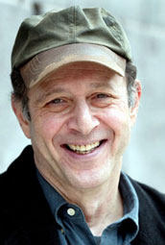
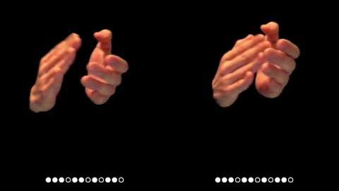
Steve Reich is an American composer, and much of his music puts emphasis on rhythmic patterns and repetitions.
In 1972 he wrote Clapping Music – listen to the piece .

Slide 3
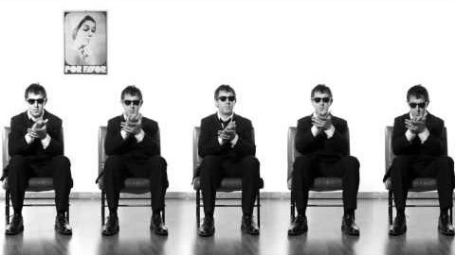
Clapping Music has been arranged and performed in various ways – here is another version
How many different body percussion sounds can you identify?

Slide 4
Questions to think about
Did you like the piece?
What was the main difference with performance 2?
Which version did you prefer and why?

Slide 5
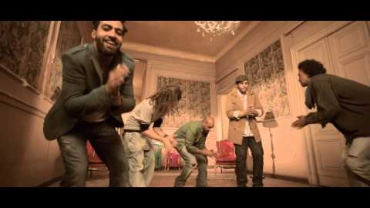
Now watch this clip that takes body percussion even further
There are some elements of PITCH involved later in this piece –how does this happen? (Answer on the next page!)

Slide 6
Answer:
The performers use the doorbell and the song to introduce pitch to the piece

Slide 7
Now make up your own body percussion rhythm piece
Try using some or all of these sounds
Stamp
Clap
Click
Tap thighs
Tap chest
Tap cheek (open and close your mouth for different pitches)
Can you teach your pattern to someone else?
First try it at the same time
Then see if the other person can start it a bit later – like a round

