Slide 1


Science
Sound
Year One
Science | Year 4 | Sound | Good Vibrations | Lesson 1

Slide 2
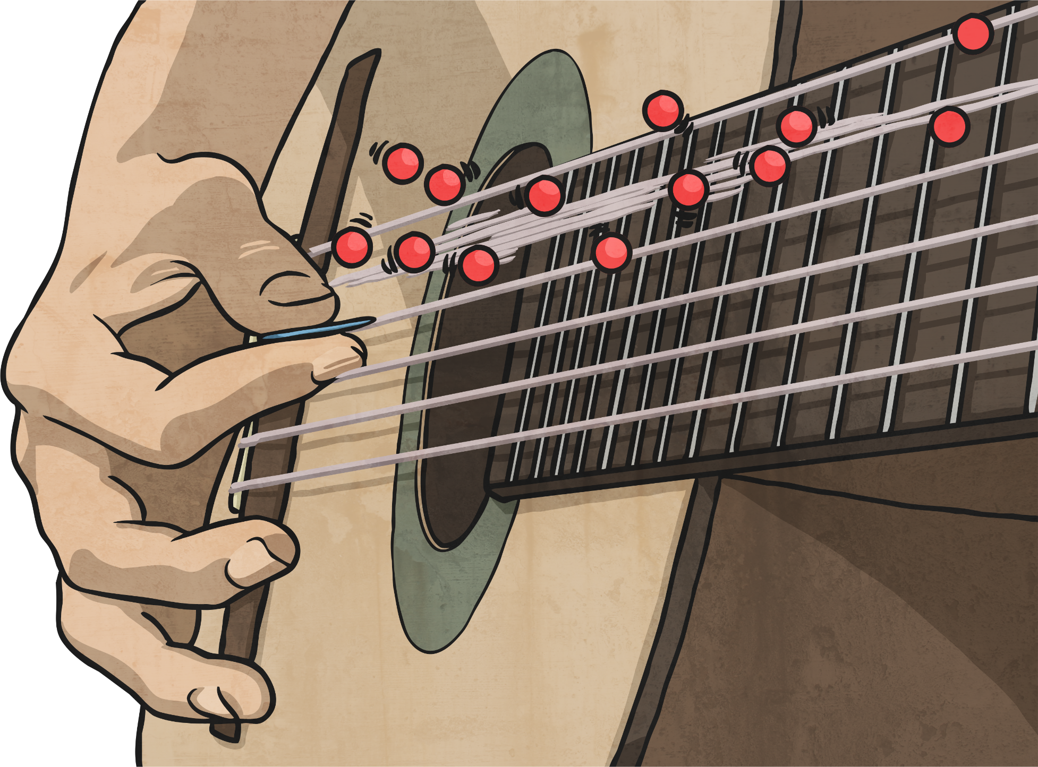

Good Vibrations

Slide 3
Aim
I can describe and explain sound sources.
Success Criteria
I can identify and describe sound sources around school.
I can explain how sources of sound vibrate, creating sound.

Slide 4

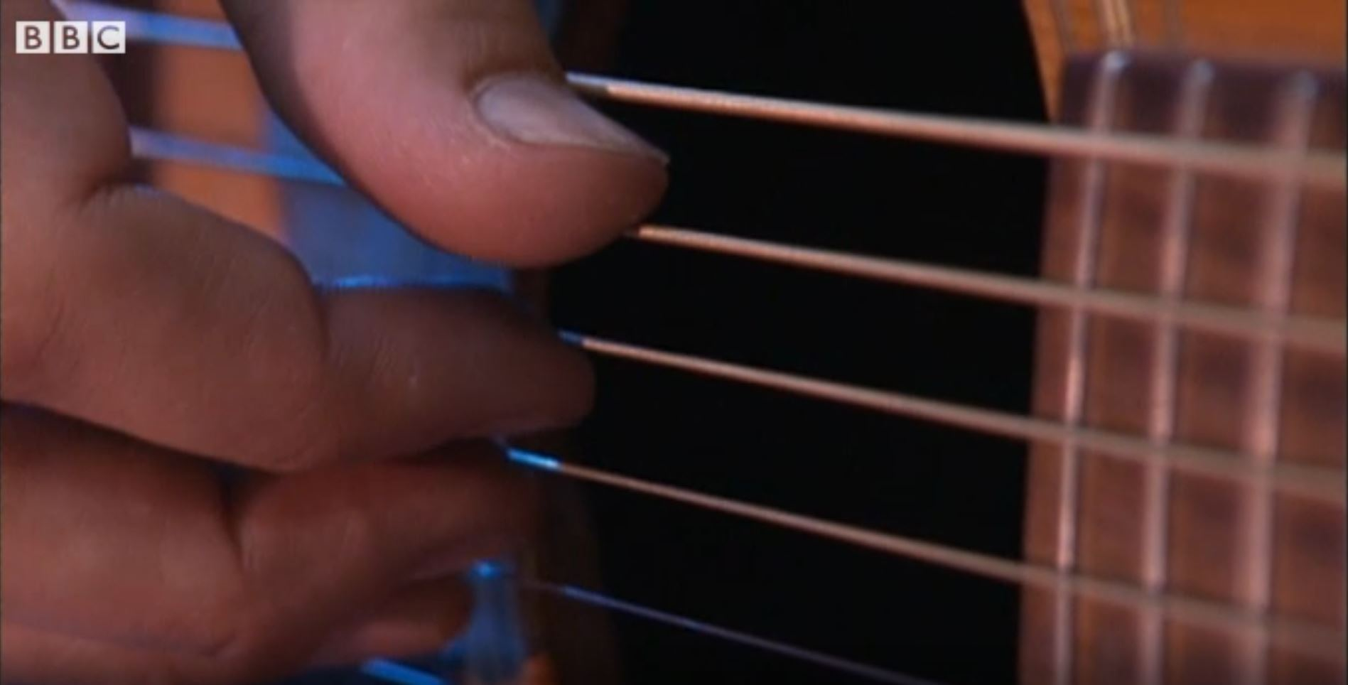
What is Sound?
Watch this clip to see to see how the different families of musical instrument create different sounds.
Click on this image to play the video in a new window.
Notes:
Teacher Note - Please check your volume is set to the appropriate level for this video. Please do not let the next video automatically play at the end of the clip. Please check the content in this link, including any comments, is suitable for your educational environment before showing. Twinkl accepts no responsibility for the content of third party websites.

Slide 5
What is Sound?
Did you come up with some words to explain how the musical instruments make sounds?
Look at the words below. Did you choose any of these words?
Vibrate
Vibration
Twang
Blow
Bang
Scrape
Shake
Pluck

Slide 6
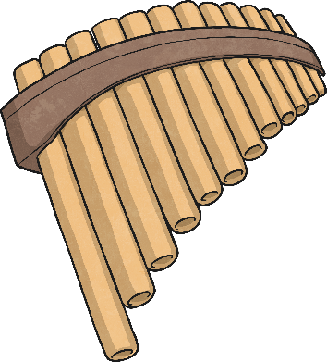
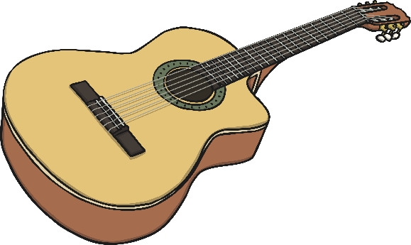
Vibrations
All the instruments are played in different ways, but they all have something in common. They all create sounds by vibrating.
The strings of the guitar and the gopichand vibrate when they are plucked.
The pan pipes and horn are filled with air, which vibrates when they are blown.
The balafon and the bongos make sounds when they are hit or banged, causing the blocks or the skin to vibrate.
But what is a vibration?

Slide 7
Vibrations
We can see and feel vibrations whenever sounds are made.
Gently place your hand on your throat.
Say ‘Ah!’
Can you feel the vibrations from your vocal cords?
Ahh

Slide 8

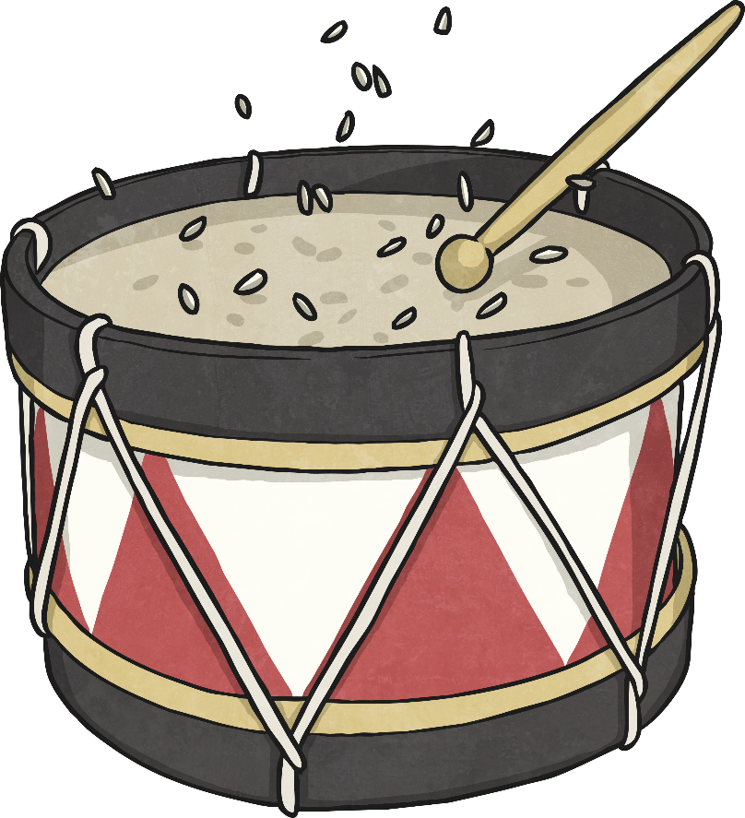
Vibrations
Place a few grains of rice on a drum skin and gently bang the drum.
The grains of rice bounce on the drum skin when it is hit.
This is because the drum skin vibrates, and the vibrations pass to the grains of rice, which also vibrate.

Slide 9
School Sound Survey
Around your house there are lots of different sounds. Some places will be noisy, whereas some places will be quiet. The loudness of the different places will even change throughout the day!
You are going to carry out a sound survey of your house to find which places are noisy and which are quiet at different times of day. You may decide to rate each place out of 5, with 5 being very noisy and 0 being totally silent.

Slide 10
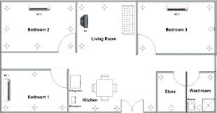
House Sound Survey
Design a map of your house in your work book to decide which places you are going to visit.
Then visit each place and rate the noise level.
Make a note of this on your house map.

Slide 11
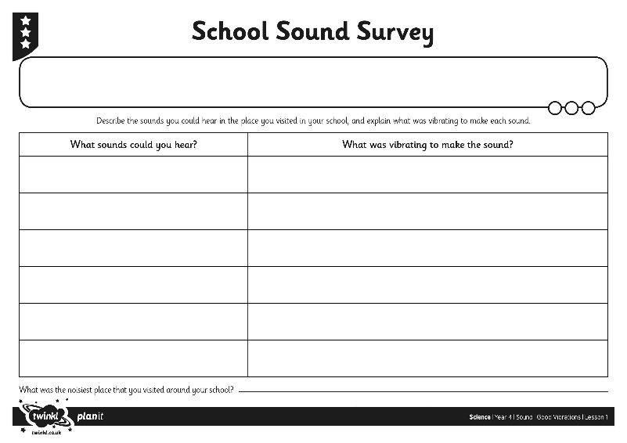
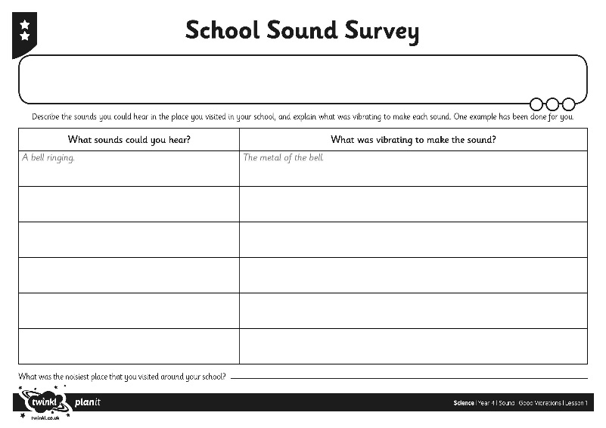
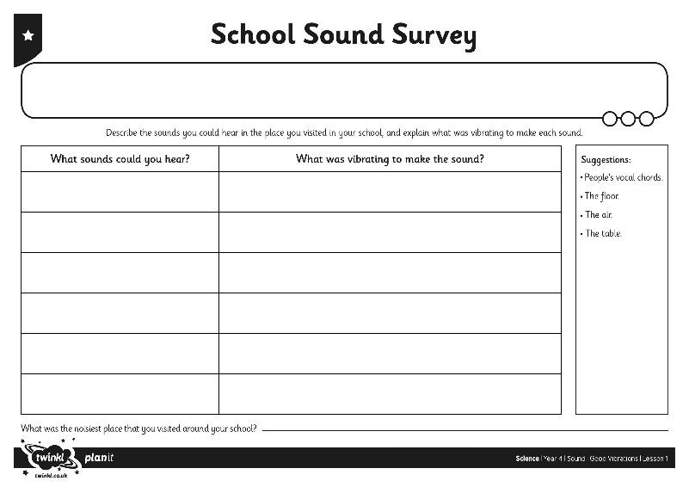
Explaining Sounds
On your Sound Survey Activity Sheet, make a list of the sounds you could hear in the noisiest place you visited around your house. For each one, think about what was vibrating to make that sound.
Complete the table on your activity sheet.

Slide 12

Aim
I can describe and explain sound sources.
Success Criteria
I can identify and describe sound sources around school.
I can explain how sources of sound vibrate, creating sound.

