Slide 1




Year 4 - Spring - Block 2
Area

Slide 2
Teddy and Eva are measuring the area of the same rectangle. Teddy uses circles to find the area.
Eva uses squares to find the area.
Whose method do you think is more reliable?
Explain why.

Slide 3


Two children have measured the top of their desk. They used different sized squares.
Dora
Alex
Who used the largest squares?
How do you know?
The area of the table top is 6 squares.
The area of the table top is 9 squares.

Slide 4
Dexter has taken a bite of the chocolate bar.
The chocolate bar was a rectangle.
Can you work out how many squares of chocolate there were to start with?

Slide 5
This rectangle has been ripped.
What is the smallest possible area of the original rectangle?
What is the largest possible area if the length of the rectangle is less than 10 squares?

Slide 6
Here is a rectilinear shape.
Using 7 more squares, can you make a rectangle?
Can you find more than one way?

Slide 7
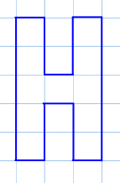
Can you make some capital letters on squared paper using less than 20 squares?
Make a word from some and count the total area of the letters.
Which letters have a line of symmetry?
What is the area of half of each letter?

Slide 8
Look at the shapes. Can you spot the pattern and explain how the area is changing each time?
Draw the next shape. What is its area?
Can you predict what the area of the 6th shape would be?
Can you spot any patterns in your answers?

Slide 9
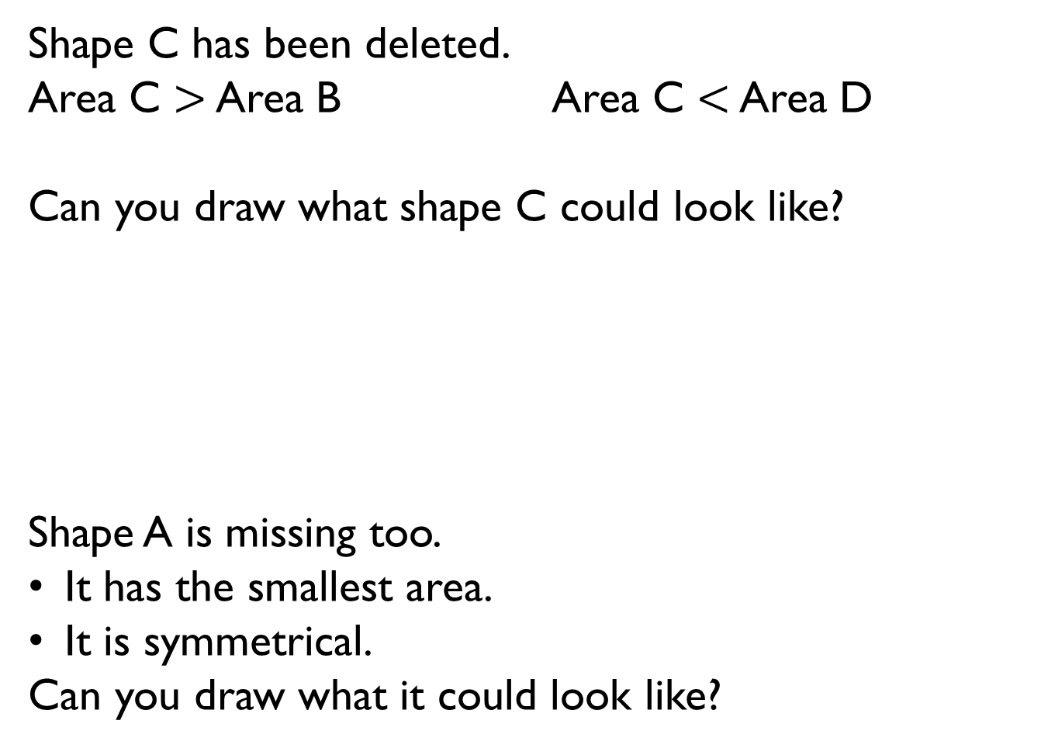
Shape C has been deleted.
Area C $>$ Area B Area C $<$ Area D
Can you draw what shape C could look like?
Shape A is missing too.
It has the smallest area.
It is symmetrical.
Can you draw what it could look like?
B
D

