Slide 1


Art and Design
Landscapes and Cityscapes
Year One
Art and Design | KS1 | Landscapes and Cityscapes | Monet’s Cityscapes | Lesson 2

Slide 2
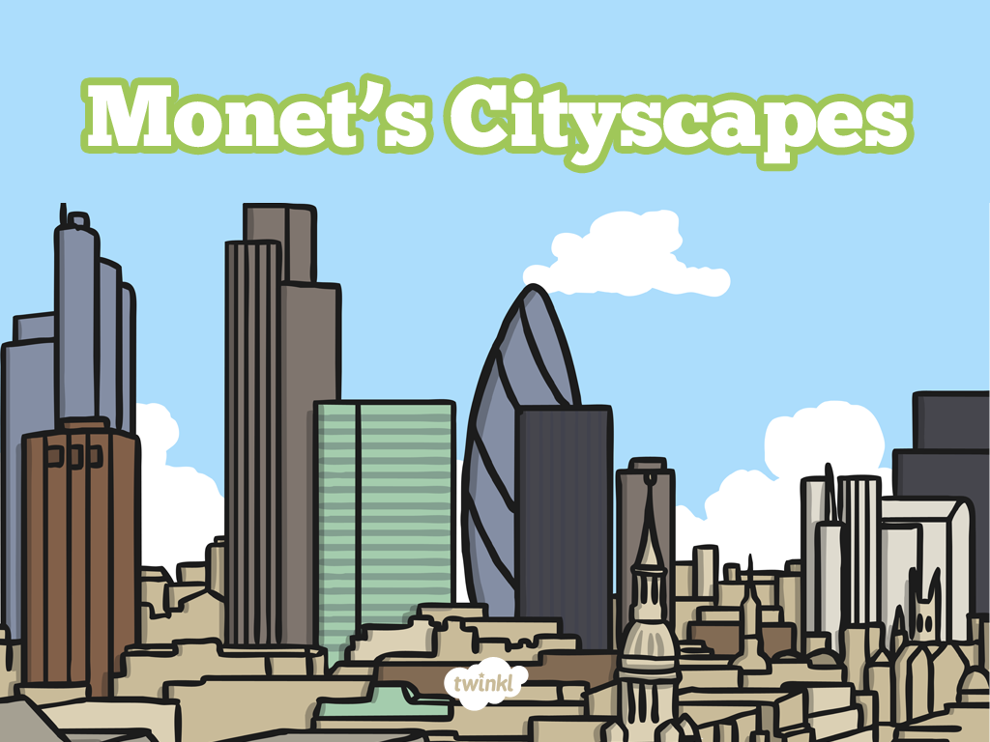

Slide 3
Aim
I can use pastels to create a cityscape.
I can describe the work of the artist, Monet.
Success Criteria
I can use pastels to create a colourful sky.
I can draw the outline of the building in my picture and leave the building the same colour as the paper.
I can create a reflection of the building in the water.
I can explain that Monet painted the same scene lots of times.
I can explain that Monet used colours to capture changing light.

Slide 4
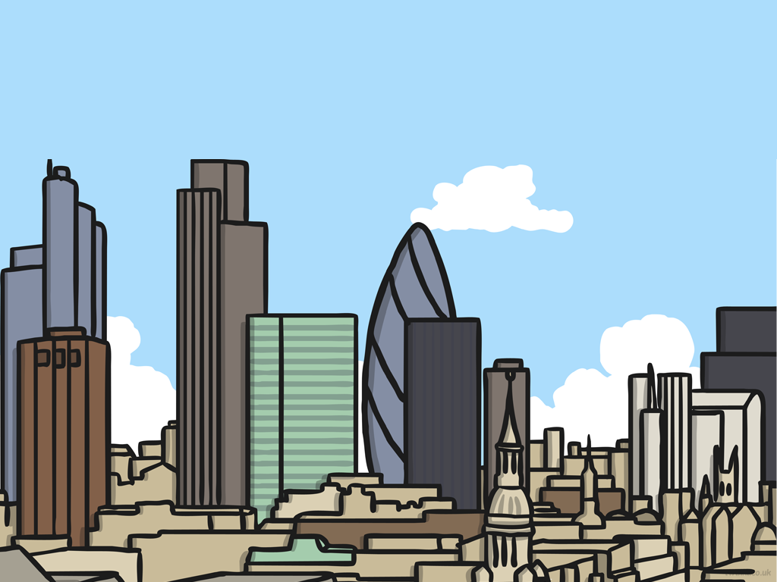
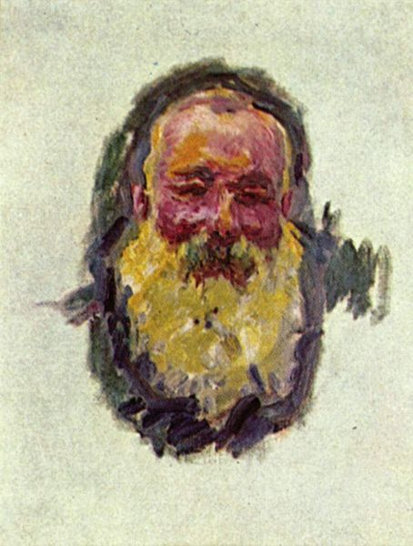
Claude Monet
Oscar-Claude Monet was a French painter, born in 1840.
He was a founder of French Impressionist painting.
The term “Impressionism” comes from the title of his painting, Impression, Sunrise.
He enjoyed painting in the outdoors, and painted landscapes at different times of day and in all kinds of weather.
He often painted the same scene more than once, to capture the changing light and different seasons.
Attribution - Photo courtesy of Joaquín Martínez (@flickr.com) - granted under creative commons licence - attribution

Slide 5

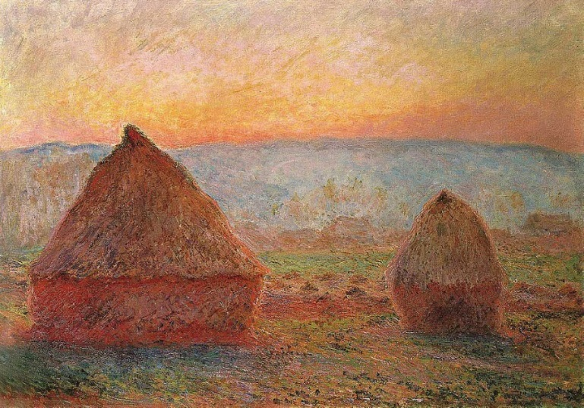
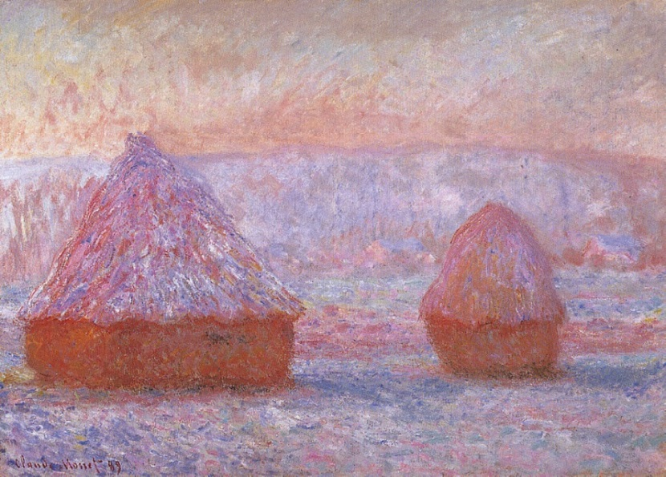
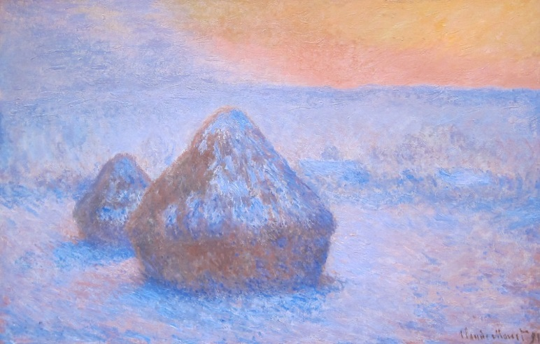
Colour and Light
Haystacks
Last lesson we looked at 3 similar paintings that Monet had painted of haystacks.
The colours were slightly different in each one.
Attribution - Photo courtesy of CarlosR38 and Sharon Mollerus (@flickr.com) - granted under creative commons licence - attribution

Slide 6



Colour and Light
Capturing Light
Monet was passionate about painting outdoors.
Monet often painted the same scene many, many times.
He was interested in capturing the changing light at different times of day.
He also painted the same scene in different seasons.
He was interested in the way that the colours differed with the time of day, the weather, and the time of year.
Attribution - Photo courtesy of CarlosR38 and Sharon Mollerus (@flickr.com) - granted under creative commons licence - attribution

Slide 7
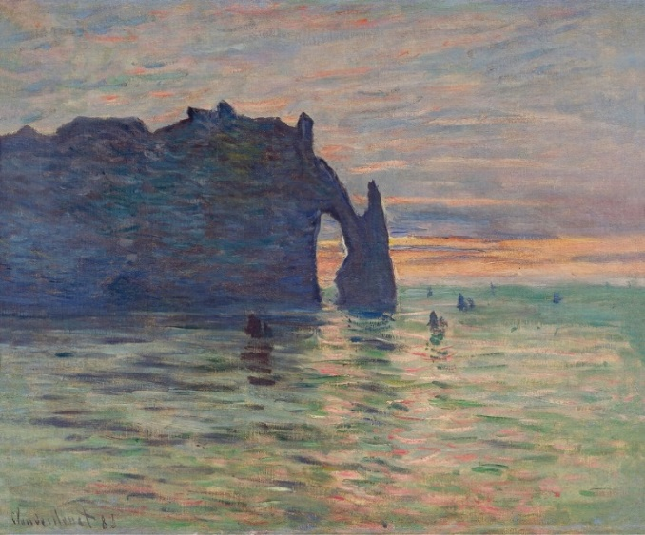
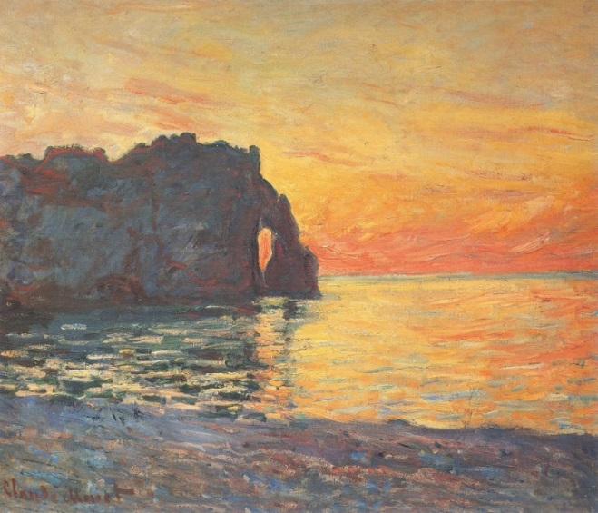
Colour and Light
Étretat Sunsets
These two paintings are similar because they both show the same place at sunset. You can see Monet’s brushstrokes in both.
There are lots of differences between them. The colours of the sky are very different. There are boats in one picture, but not the other. Perhaps these paintings were painted in different weather, or in different seasons.
Étretat, Sunset, 1883
Étretat, Cliff of Aval, Sunset, 1885
Attribution - Photo courtesy of CarlosR38 (@flickr.com) - granted under creative commons licence - attribution

Slide 8
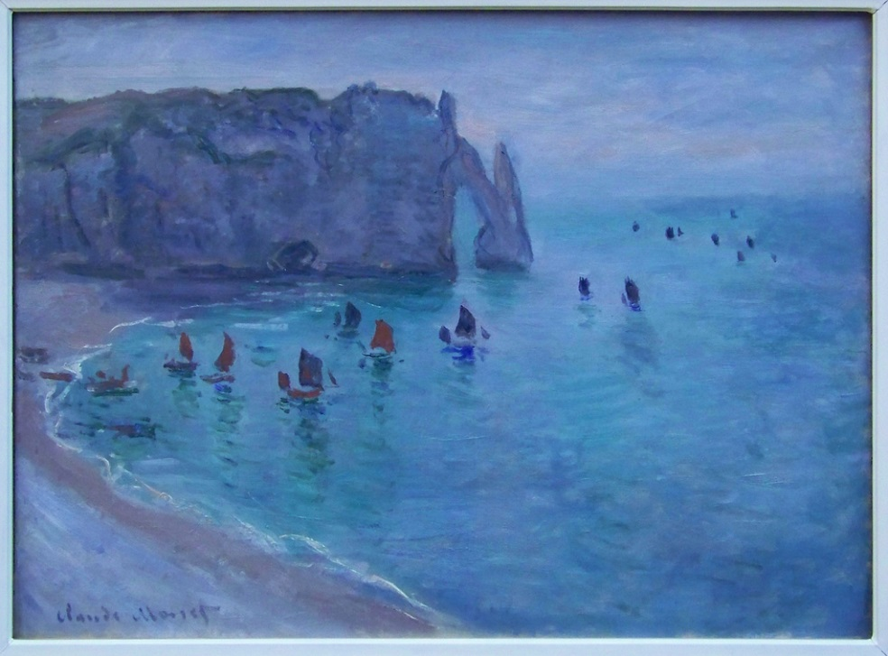
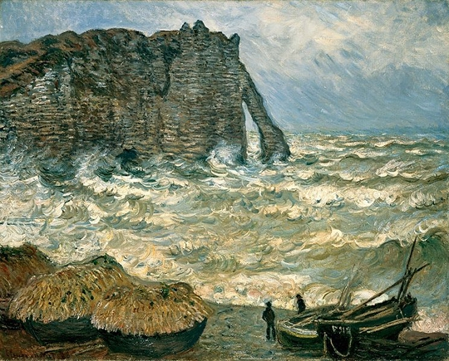
Spot the Difference
Here are 2 more paintings of Étretat.
How are they similar?
How are they different?
Monet - Étretat, la Porte d'Aval, 1885
Stormy Sea in Étretat 1883
Attribution - Photo courtesy of Eusebius@Commons and jwyg (@flickr.com) - granted under creative commons licence - attribution

Slide 9
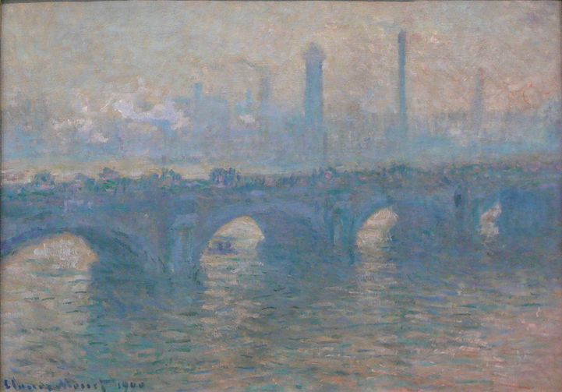
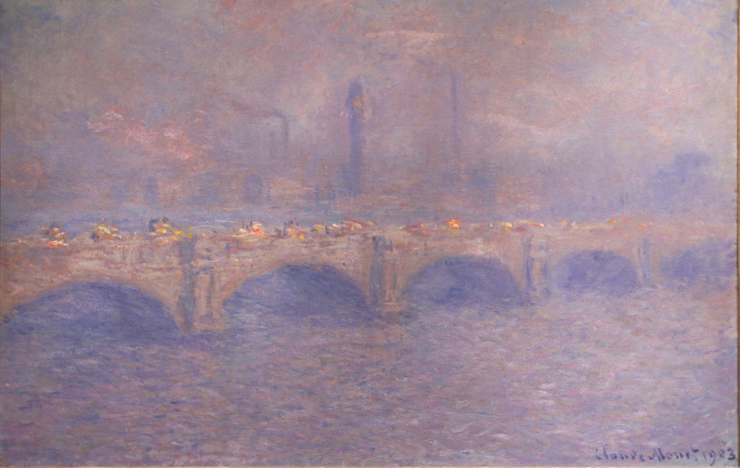
Cityscapes
Waterloo Bridge
As well as painting landscapes many times, Monet also painted lots of cityscapes over and over again.
Here are 2 different paintings of Waterloo Bridge in London, England.
Waterloo Bridge, 1900
Waterloo Bridge Sunlight Effect, 1903
Attribution - Photo courtesy of CarlosR38 and Tony Hisgett (@flickr.com) - granted under creative commons licence - attribution

Slide 10
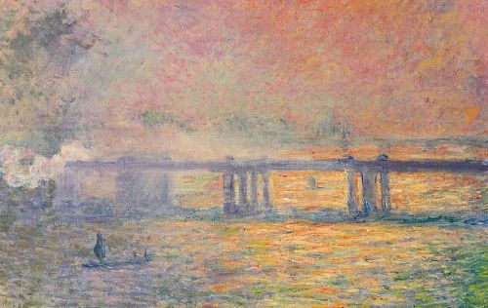
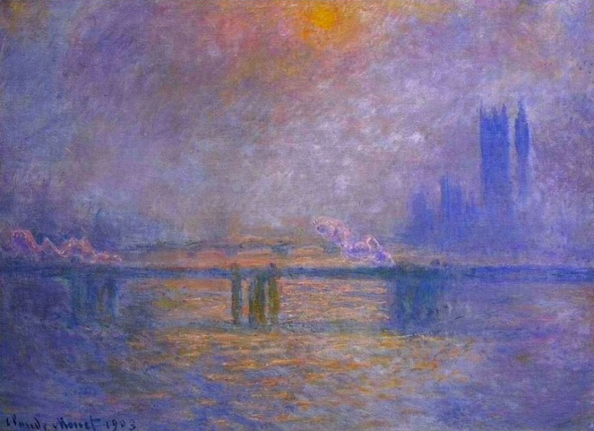
Cityscapes
Charing Cross Bridge
Monet painted Charing Cross Bridge in London lots of times.
We are going to see 6 different paintings of Charing Cross Bridge by Monet.
Think about what stays the same and what changes.
Charing Cross Bridge, 1899-1901
Charing Cross Bridge, 1903
Attribution - Photo courtesy of emmeffe6 (@flickr.com) - granted under creative commons licence - attribution

Slide 11
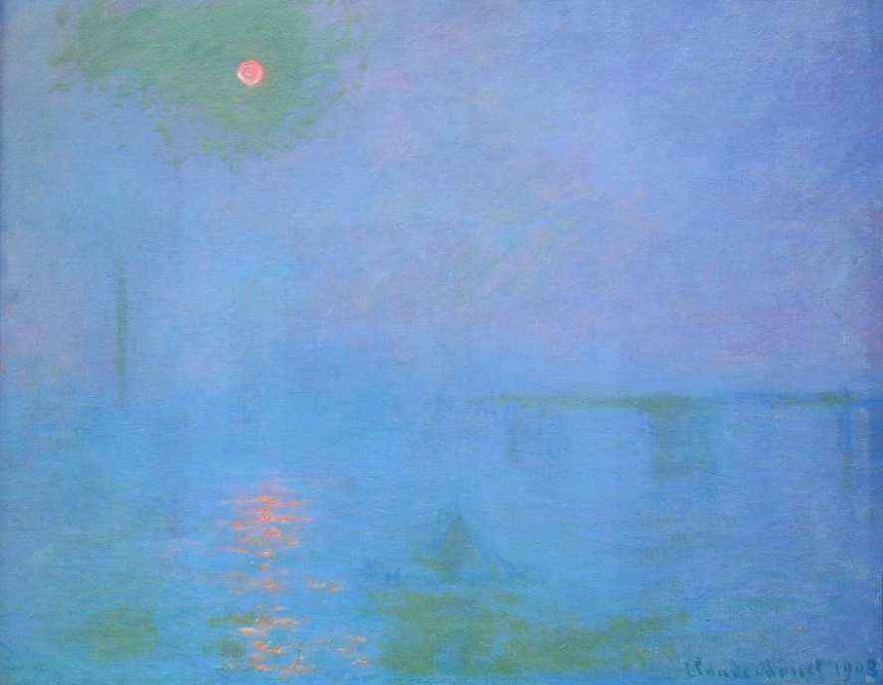
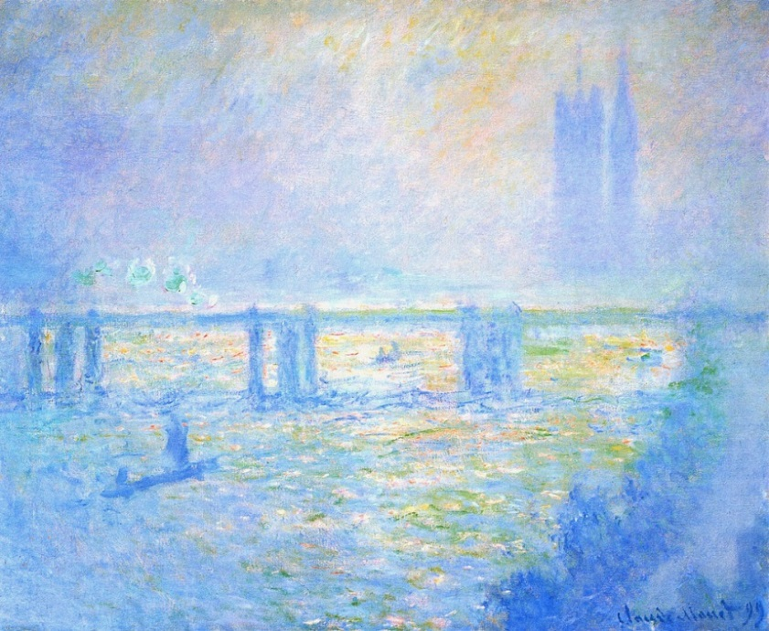
Cityscapes
Charing Cross Bridge
Charing Cross Bridge, 1899-1901
Charing Cross Bridge, 1903
Attribution - Photo courtesy of CarlosR38 (@flickr.com) - granted under creative commons licence - attribution

Slide 12
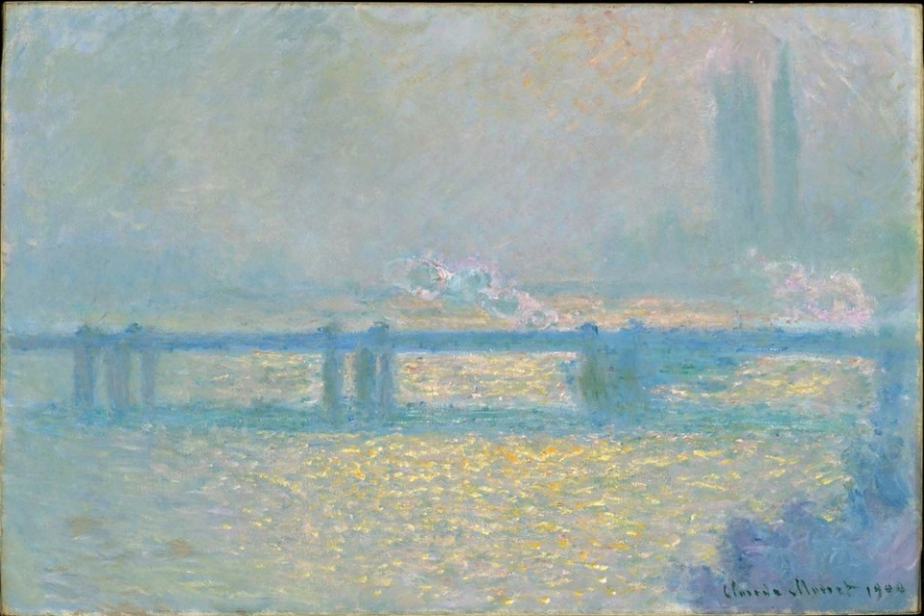
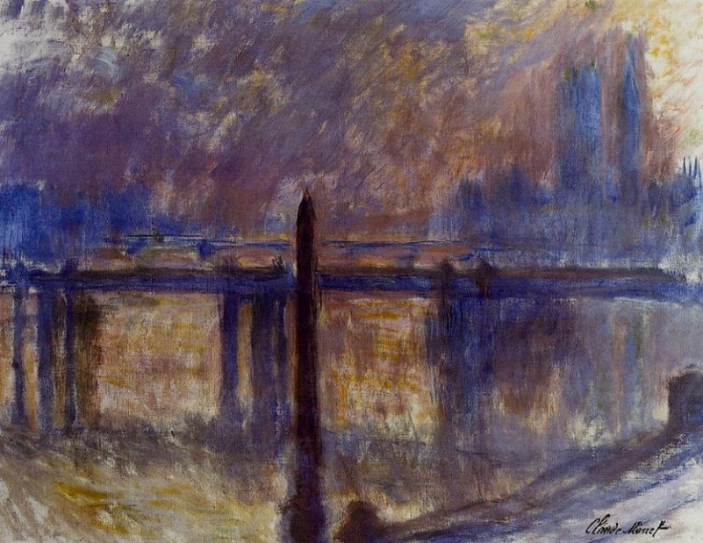
Cityscapes
Charing Cross Bridge
Charing Cross Bridge, 1899-1901
Charing Cross Bridge, 1903
Attribution - Photo courtesy of CarlosR38 (@flickr.com) - granted under creative commons licence - attribution

Slide 13
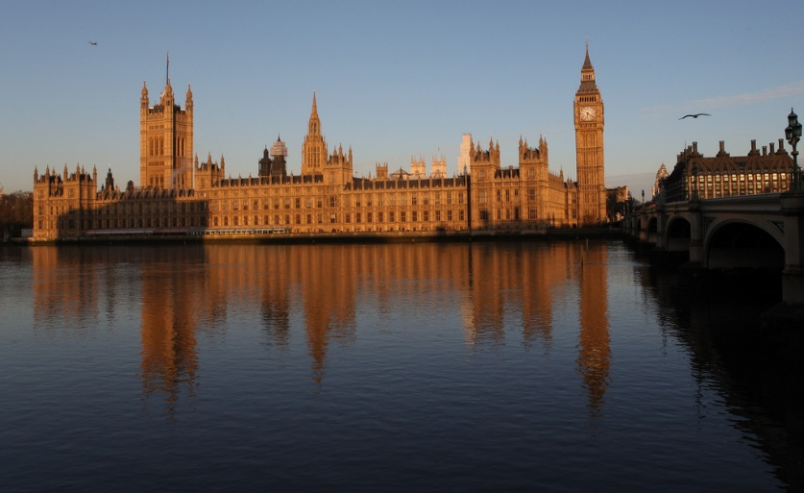
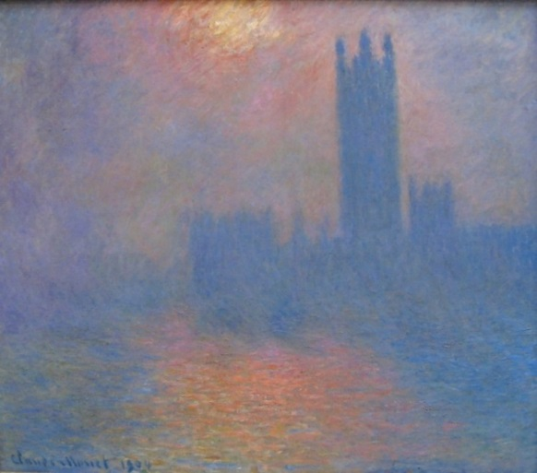
Houses of Parliament
Monet painted the Houses of Parliament, in London, many times.
He looked out of the window of his hotel to paint the famous building.
He liked to paint at certain times of day so that the building was a silhouette.
We are going to look at 2 of these paintings. Think about how they are different.
Attribution - Photo courtesy of Martin Hesketh and Sharon Mollerus (@flickr.com) - granted under creative commons licence - attribution

Slide 14
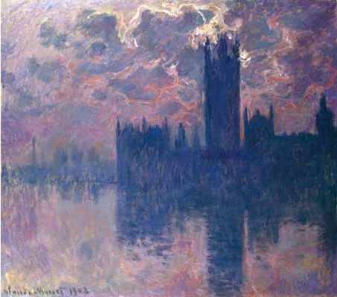
1902
Houses of Parliament
Attribution - Photo courtesy of emmeffe6 (@flickr.com) - granted under creative commons licence - attribution

Slide 15
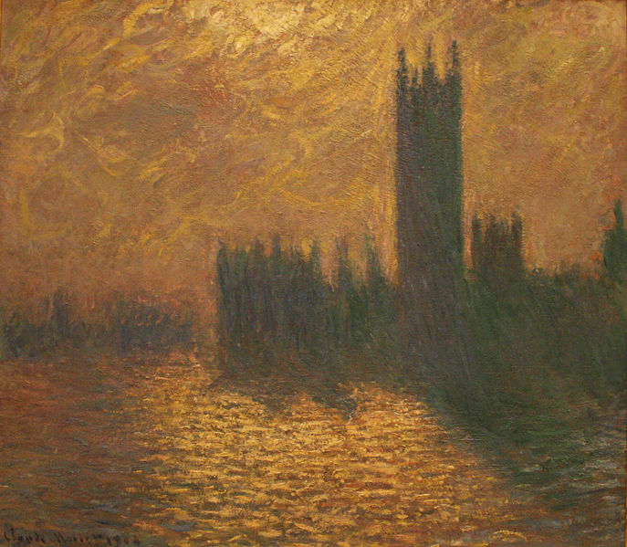
1904
Houses of Parliament

Slide 16

Today
Today we are going to recreate these 2 paintings by Monet. You could use pastels, paint, pencils, pens or purplemash.
You will need to use the same colours for the sky and the reflection.
Try to use blues and purples for one of the pictures, and reds and yellows for the other.
Start by drawing an outline of the building on the paper, and colour carefully around it.
Be careful not to smudge your work.
Attribution - Photo courtesy of emmeffe6 (@flickr.com) - granted under creative commons licence - attribution

Slide 17

Landscapes or Cityscapes?
Do you prefer Monet’s Landscapes or Cityscapes?
Explain your answer to your partner.
Attribution - Photo courtesy of CarlosR38 (@flickr.com) - granted under creative commons licence - attribution

Slide 18

Aim
I can use pastels to create a cityscape.
I can describe the work of the artist, Monet.
Success Criteria
I can use pastels to create a colourful sky.
I can draw the outline of the building in my picture and leave the building the same colour as the paper.
I can create a reflection of the building in the water.
I can explain that Monet painted the same scene lots of times.
I can explain that Monet used colours to capture changing light.

