Slide 1




Year 4 - Spring - Block 3
Fractions

Slide 2

Always, Sometimes, Never?
Alex says,
Explain your answer.
If I split a shape into 4 parts, I have split it into quarters.

Slide 3
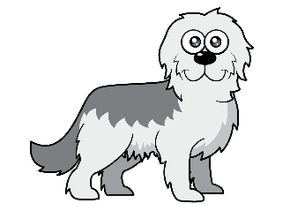

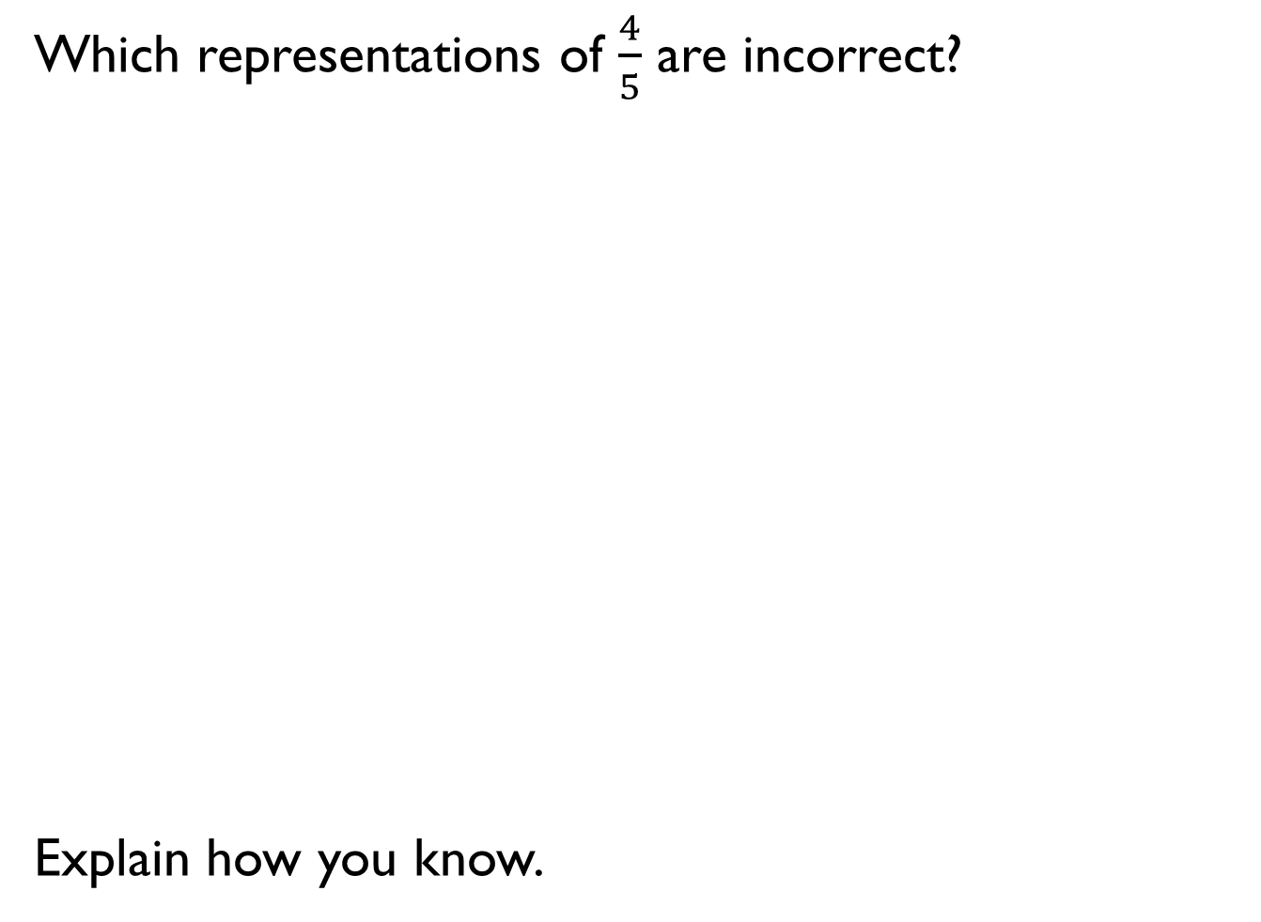
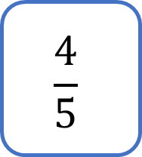
Which representations of $\frac{4}{5}$ are incorrect?
Explain how you know.
$$\frac{4}{5}$$

Slide 4
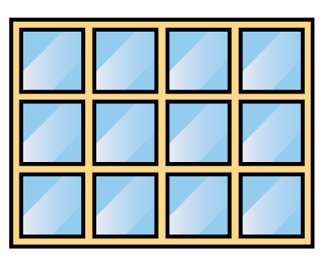
How many equivalent fractions can you see in this picture?

Slide 5

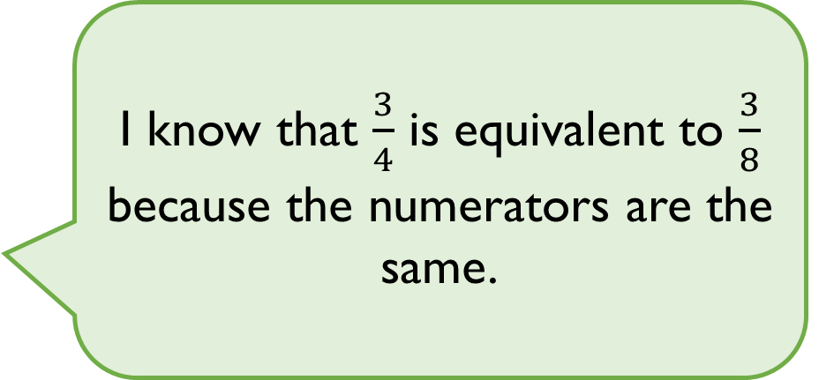
Eva says,
Is Eva correct?
Explain why.
I know that $\frac{3}{4}$ is equivalent to $\frac{3}{8}$ because the numerators are the same.

Slide 6
Ron has two strips of the same sized paper.
He folds the strips into different sized fractions.
He shades in three equal parts on one strip and six equal parts on the other strip.
The shaded areas are equal.
What fractions could he have folded his strips into?

Slide 7

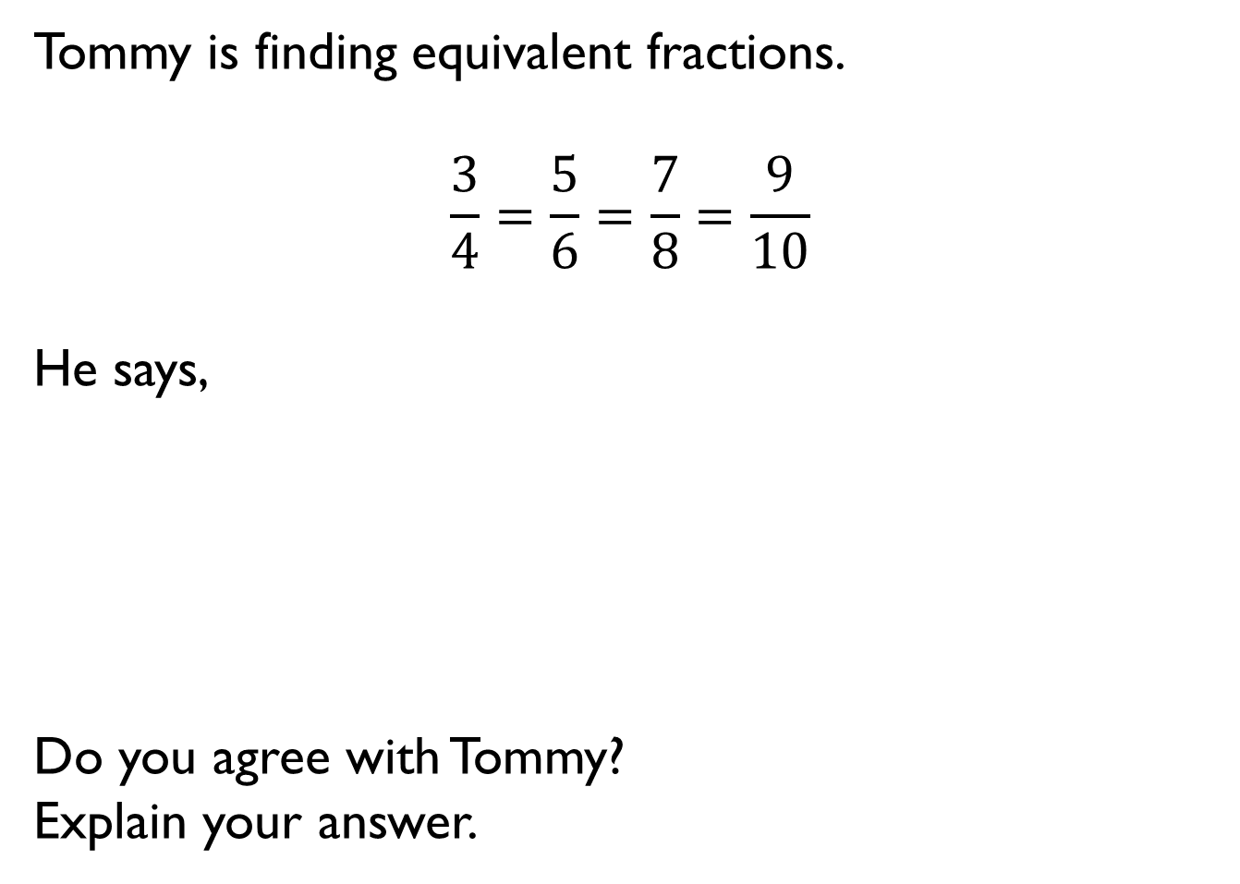
Tommy is finding equivalent fractions.
$$\frac{3}{4}=\frac{5}{6}=\frac{7}{8}=\frac{9}{10}$$
He says,
Do you agree with Tommy?
Explain your answer.
I did the same thing to the numerator and the denominator so my fractions are equivalent.

Slide 8
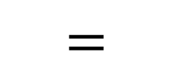
Use the digit cards to complete the equivalent fractions.
How many different ways can you find?
1
2
3
4
6
8
$$=$$

Slide 9


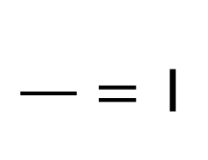
3 friends share some pizzas.
Each pizza is cut into 8 equal slices.
Altogether, they eat 25 slices.
How many whole pizzas do they eat?
$$\frac{}{}=\text{1}$$

Slide 10




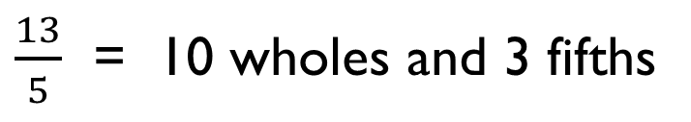
Spot the mistake.
$\frac{13}{5}$ = 10 wholes and 3 fifths

Slide 11

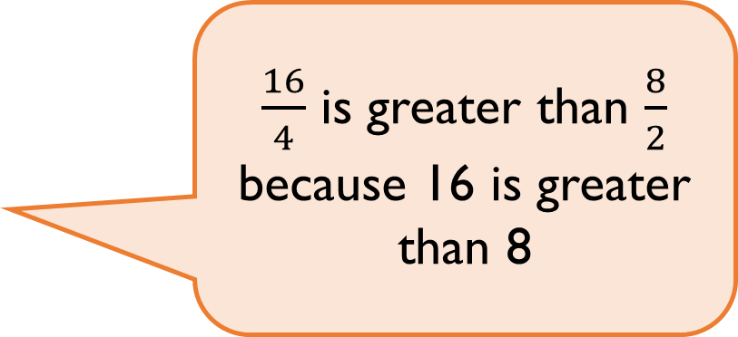
Rosie says,
Do you agree?
Explain why.
$\frac{16}{4}$ is greater than $\frac{8}{2}$ because 16 is greater than 8

Slide 12

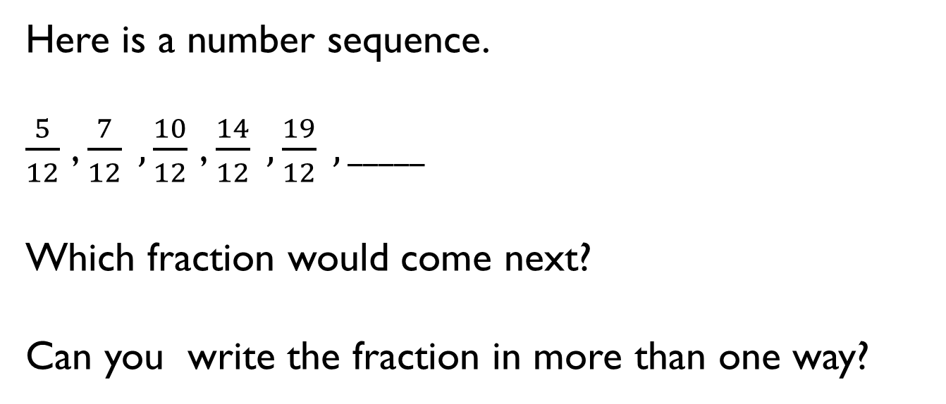
Here is a number sequence.
$\frac{5}{12}$ , $\frac{7}{12} , \frac{10}{12}$ , $\frac{14}{12} , \frac{19}{12} , _____$
Which fraction would come next?
Can you write the fraction in more than one way?
0
1
2
0
1

Slide 13
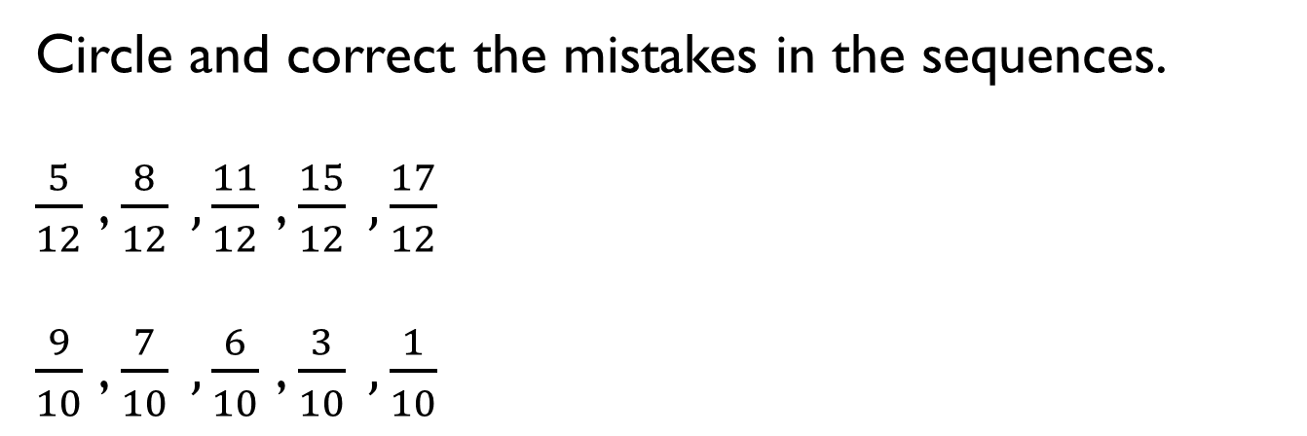
Circle and correct the mistakes in the sequences.
$\frac{5}{12}$ , $\frac{8}{12} , \frac{11}{12}$ , $\frac{15}{12} , \frac{17}{12}$
$\frac{9}{10}$ , $\frac{7}{10} , \frac{6}{10}$ , $\frac{3}{10} , \frac{1}{10}$

Slide 14
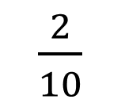
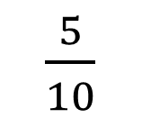
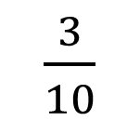
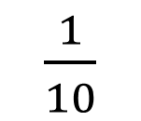
Play the fraction game for four players. Place the four fraction cards on the floor. Each player stands in front of a fraction. We are going to count up in tenths starting at 0. When you say a fraction, place your foot on your fraction.
How can we make 4 tenths?
What is the highest fraction we can count to?
How about if we used two feet?
$\frac{1}{10}$
$\frac{2}{10}$
$\frac{3}{10}$
$\frac{5}{10}$

Slide 15
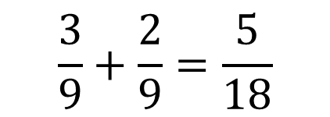
Alex is adding fractions.
Is she correct?
Explain why.
$$\frac{3}{9}+\frac{2}{9}=\frac{5}{18}$$

Slide 16
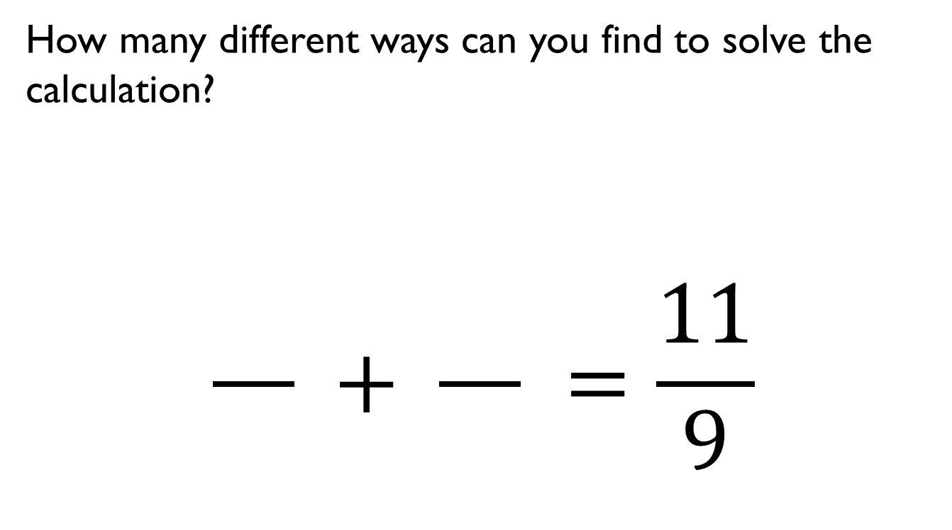
How many different ways can you find to solve the calculation?
$$\frac{}{} + \frac{}{} =\frac{11}{9}$$

Slide 17


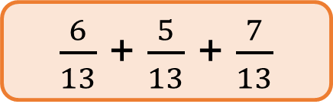

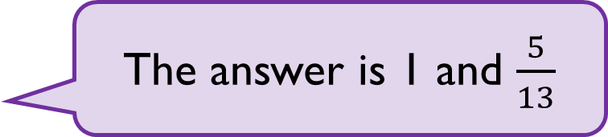
Mo and Teddy are solving:
Mo
Teddy
Who do you agree with?
Explain why.
$\frac{6}{13}$ + $\frac{5}{13}$ + $\frac{7}{13}$
The answer is 1 and $\frac{5}{13}$
The answer is$\frac{18}{13}$

Slide 18
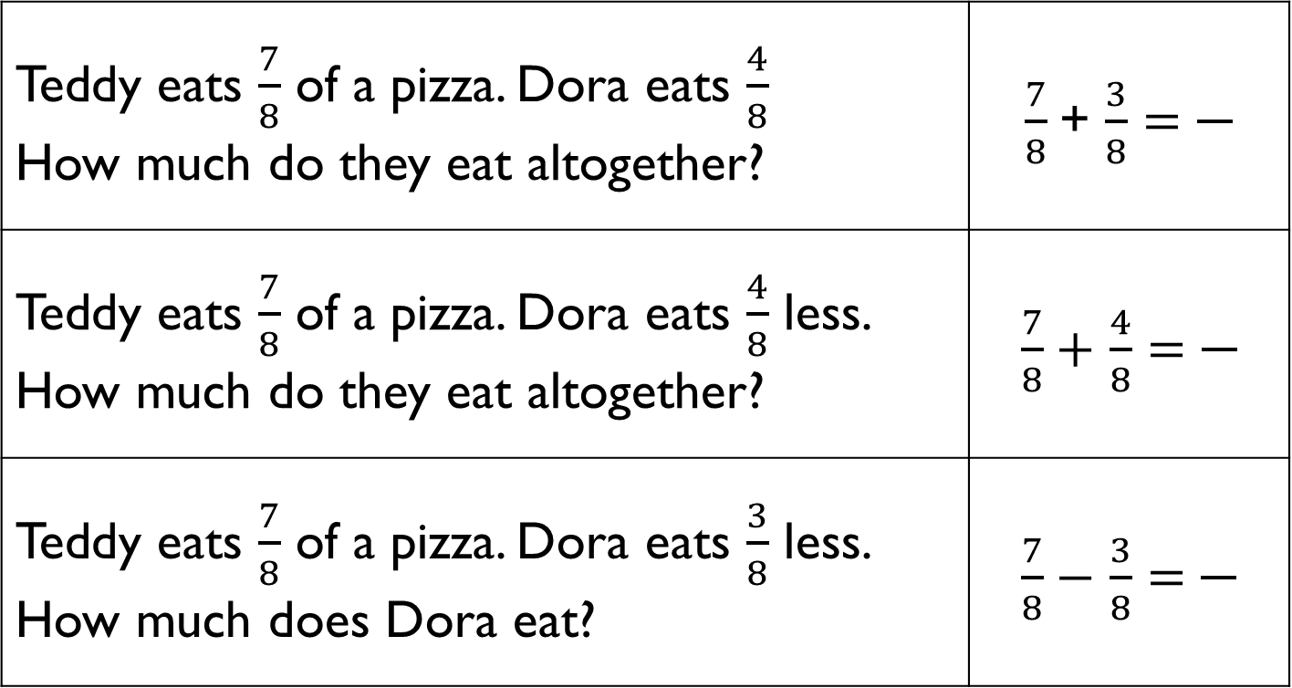
Match the number stories to the correct calculations.
Teddy eats $\frac{7}{8}$ of a pizza. Dora eats $\frac{4}{8}$ How much do they eat altogether? | $\frac{7}{8}$+ $\frac{3}{8}$ $=$
Teddy eats $\frac{7}{8}$ of a pizza. Dora eats $\frac{4}{8}$ less. How much do they eat altogether? | $\frac{7}{8}+$ $\frac{4}{8}$ $=\frac{}{}$
Teddy eats $\frac{7}{8}$ of a pizza. Dora eats $\frac{3}{8}$ less. How much does Dora eat? | $\frac{7}{8}−$ $\frac{3}{8}$ $=$

Slide 19
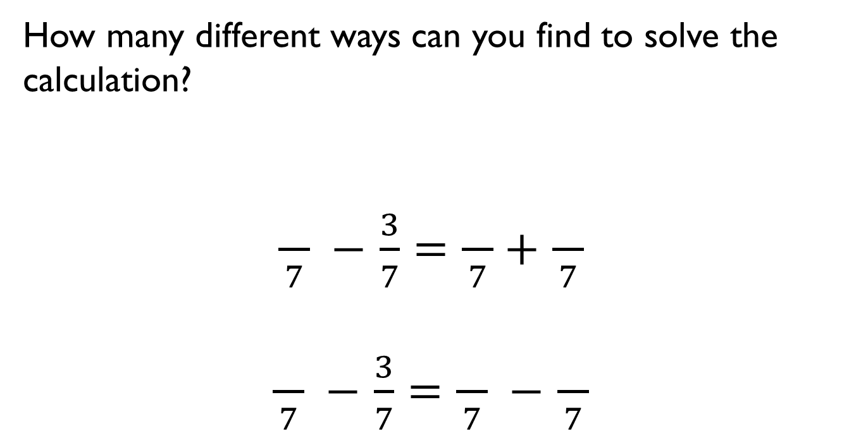
How many different ways can you find to solve the calculation?
$\frac{}{7} −$ $\frac{3}{7}=\frac{}{7}+$ $\frac{}{7}$
$\frac{}{7} −$ $\frac{3}{7}=\frac{}{7} −$ $\frac{}{7}$

Slide 20


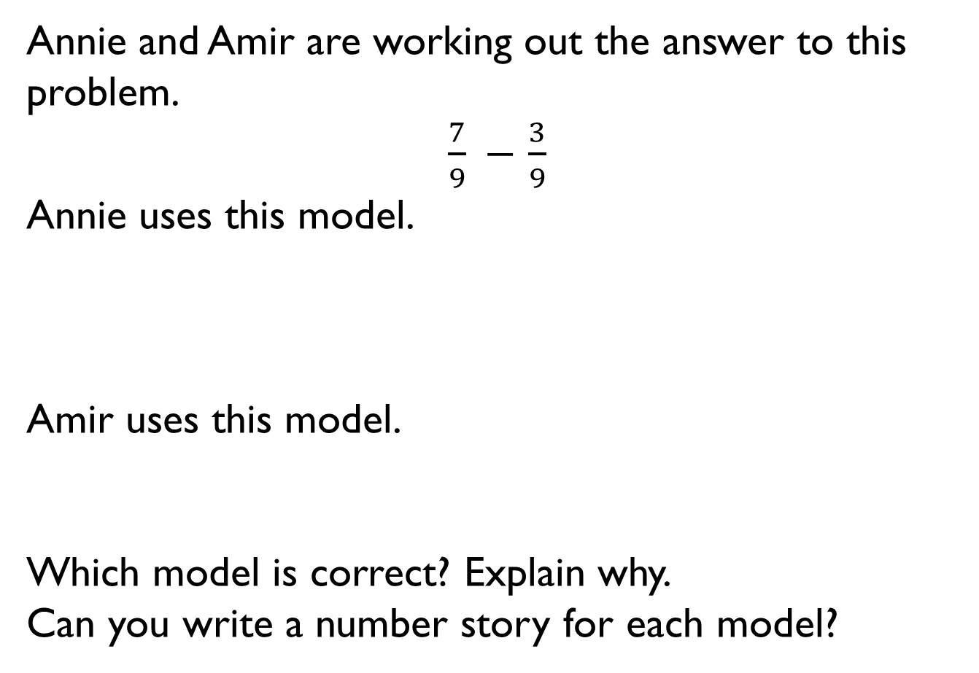
Annie and Amir are working out the answer to this problem.
$\frac{7}{9} −$ $\frac{3}{9}$
Annie uses this model.
Amir uses this model.
Which model is correct? Explain why.
Can you write a number story for each model?
?

Slide 21

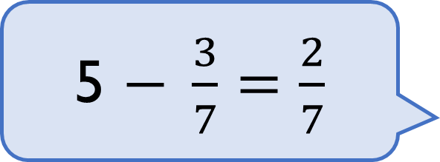
Dora is subtracting a fraction from a whole.
Can you spot her mistake?
What should the answer be?
5 $− \frac{3}{7}=$ $\frac{2}{7}$

Slide 22
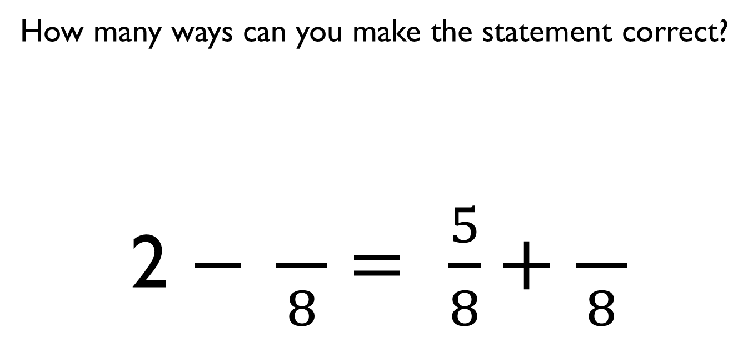
How many ways can you make the statement correct?
2 $− \frac{}{8}=$ $\frac{5}{8}+$ $\frac{}{8}$

Slide 23
Whitney has a piece of ribbon that is 3 metres long.
She cuts it into 12 equal pieces and gives Teddy 3 pieces.
How many metres of ribbon does Whitney have left?

Slide 24

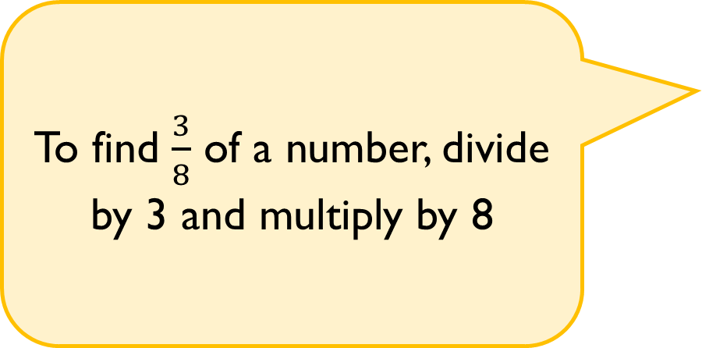
True or False?
Convince me.
To find $\frac{3}{8}$ of a number, divide by 3 and multiply by 8

Slide 25
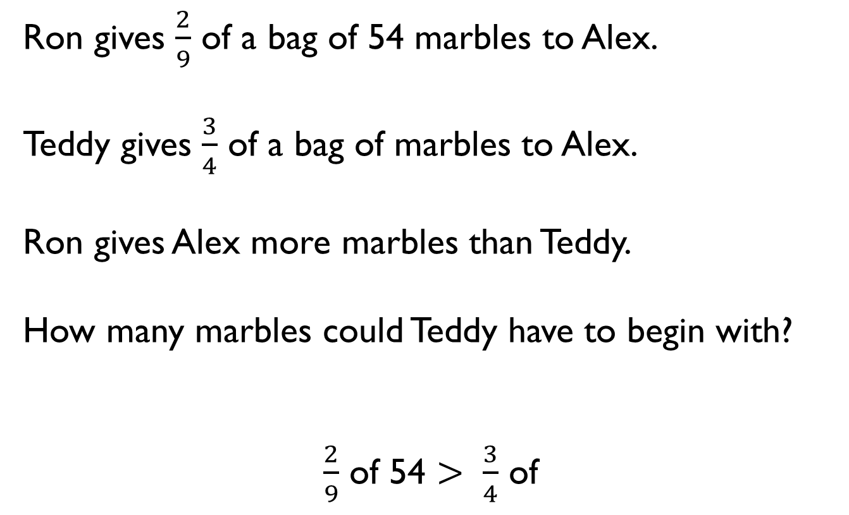
Ron gives $\frac{2}{9}$ of a bag of 54 marbles to Alex.
Teddy gives $\frac{3}{4}$ of a bag of marbles to Alex.
Ron gives Alex more marbles than Teddy.
How many marbles could Teddy have to begin with?
$\frac{2}{9}$ of 54 $>$ $\frac{3}{4}$ of

Slide 26


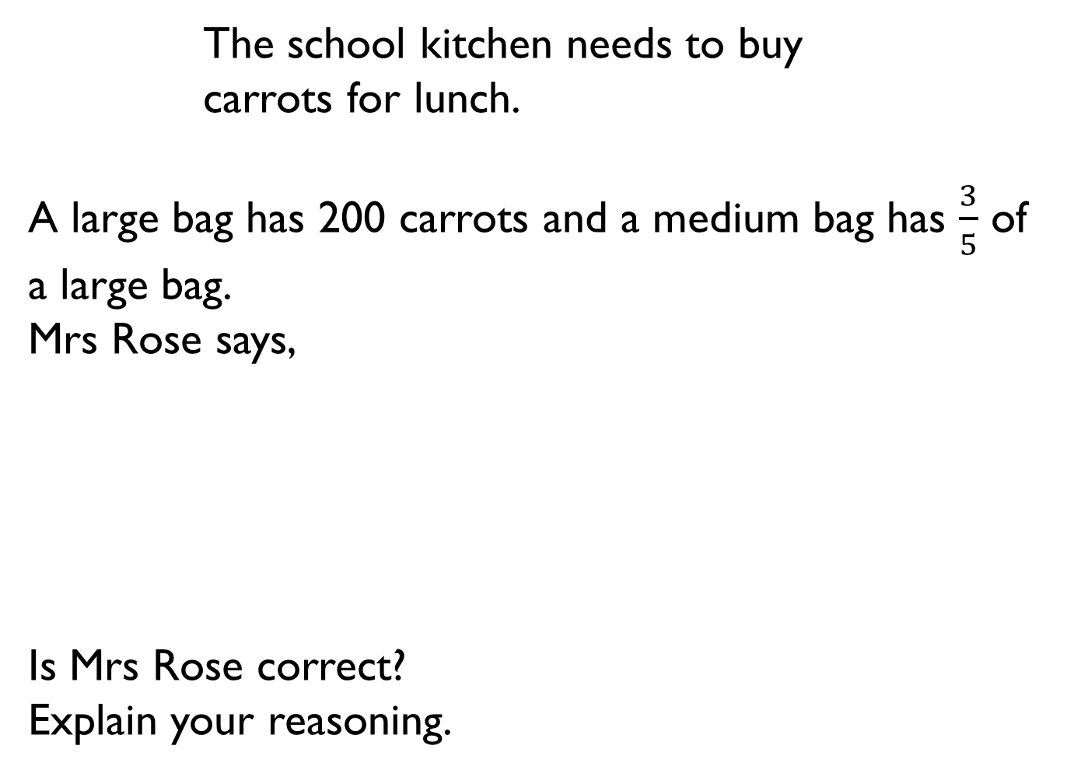
The school kitchen needs to buy
carrots for lunch.
A large bag has 200 carrots and a medium bag has $\frac{3}{5}$ of a large bag.
Mrs Rose says,
Is Mrs Rose correct?
Explain your reasoning.
I need 150 carrots so I will have to buy a large bag.

Slide 27
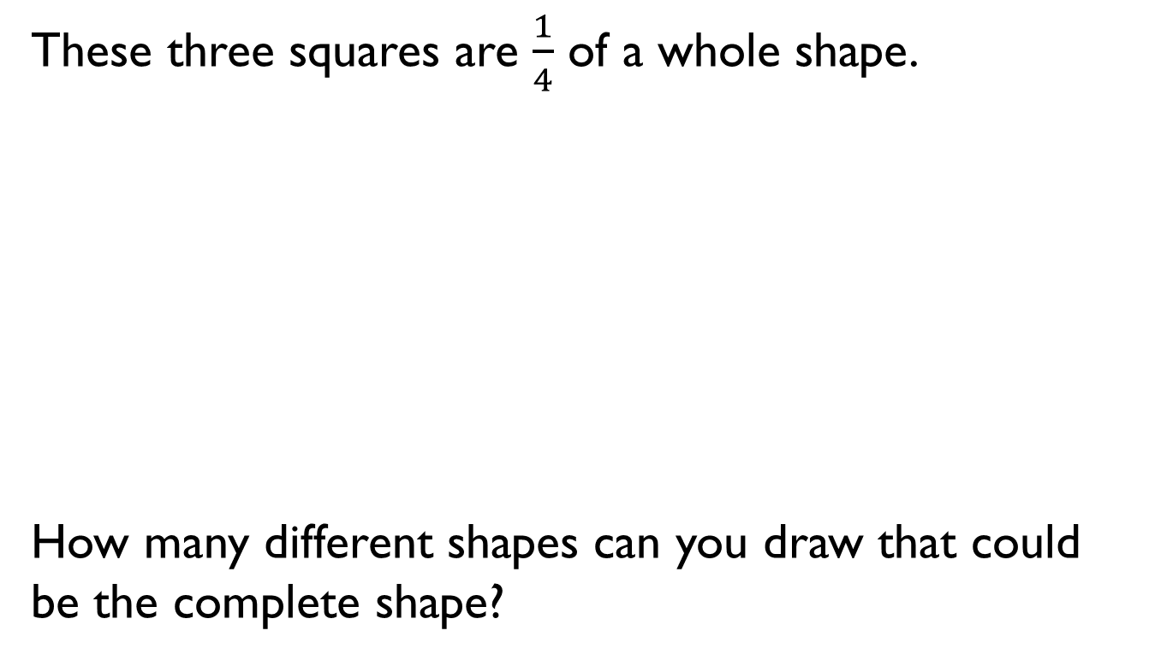
These three squares are $\frac{1}{4}$ of a whole shape.
How many different shapes can you draw that could be the complete shape?

Slide 28
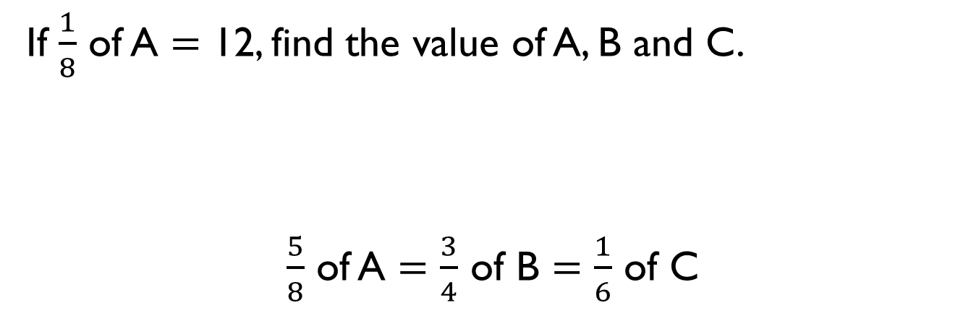
If $\frac{1}{8}$ of A $=$ 12, find the value of A, B and C.
$\frac{5}{8}$ of A $=$ $\frac{3}{4}$ of B $=$ $\frac{1}{6}$ of C

