Slide 1


Science
Plants
Year One
Science | Year 3 | Plants | Parts of Plants | Lesson 1

Slide 2
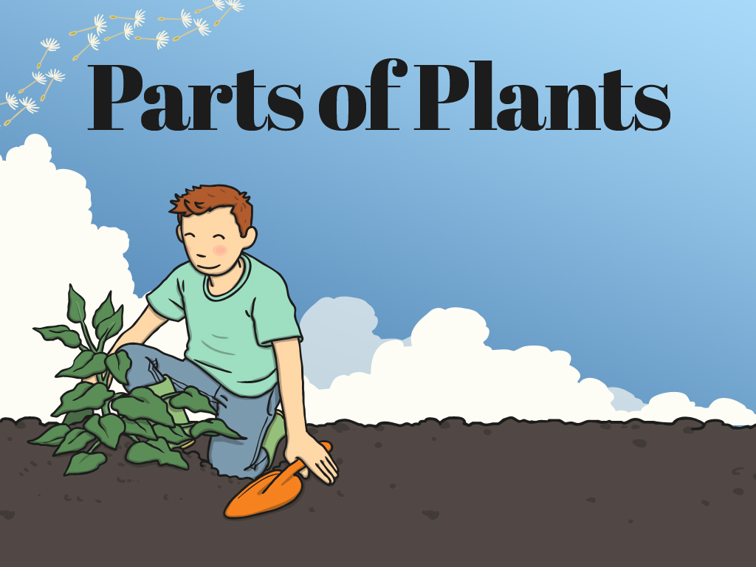



Slide 3
Aim
I can name the different parts of flowering plants and explain
their jobs.
Success Criteria
I can name the different parts of a plant.
I can explain the jobs that the different parts of a plant do.

Slide 4



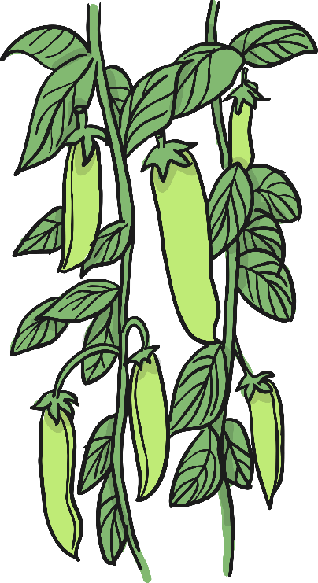




Plants!
We are going to be learning about plants.
Do you recognise any of these plants?
Do you know what the different parts of the plants are called?

Slide 5

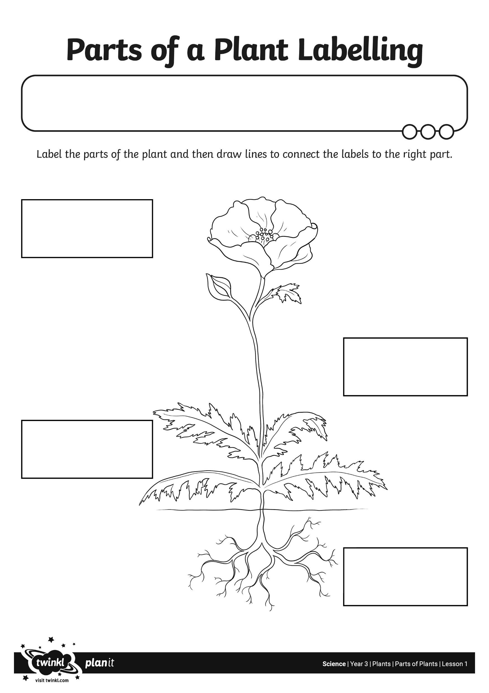
Parts of a Plant Activity 1
Plants have different parts that do different jobs.
Do you know the names of the different parts of a plant?
Work with a partner to fill in the blank labels on the plant on your activity sheet.

Slide 6
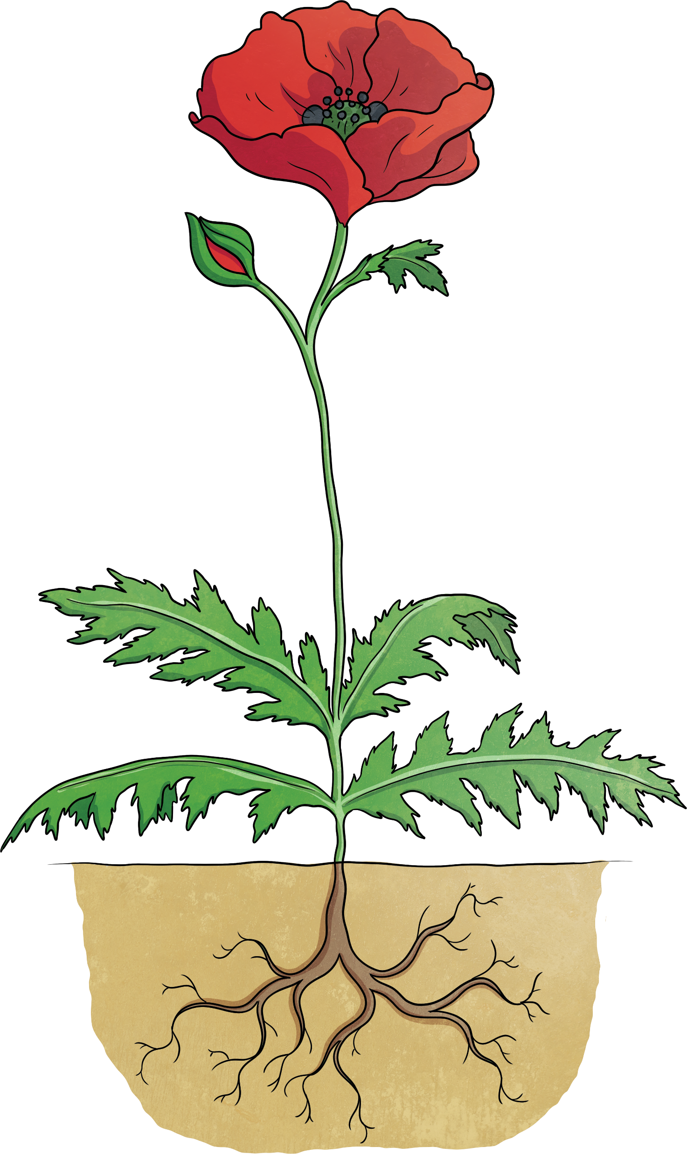
Parts of a Plant:
How Did You Do?
Flower
Stem
Leaves
Roots

Slide 7
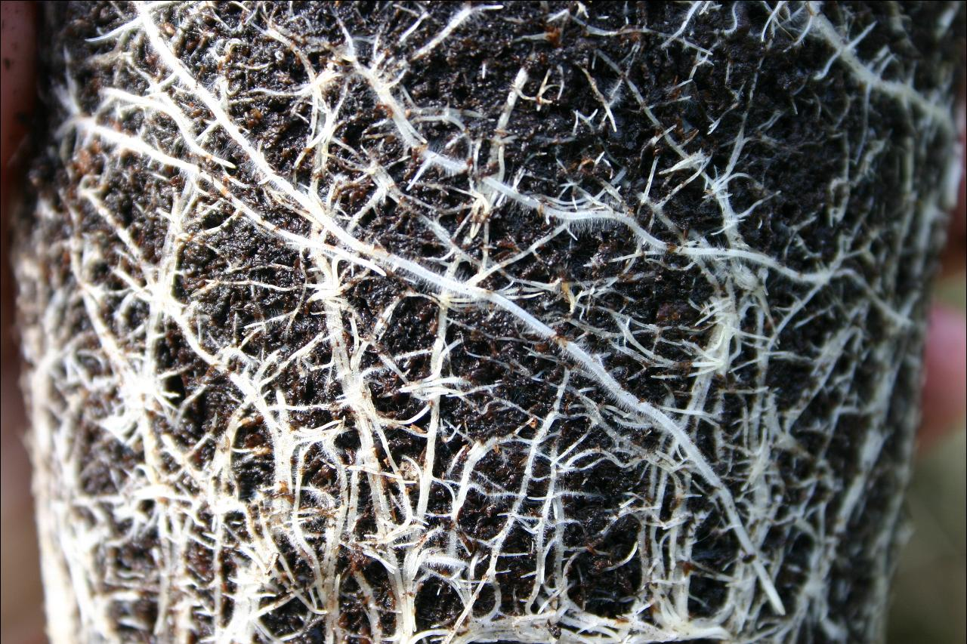
What Jobs Do They Do?
Roots
Where do we find the roots of a plant?
They grow underneath a plant, below the surface of the soil.
Roots are usually long and are covered in small hairs.
What do you think their jobs are?
The roots anchor the plant in the ground.
They absorb water and nutrients from the soil.
Photo courtesy of barnoid @flickr.com) - granted under creative commons licence – attribution

Slide 8
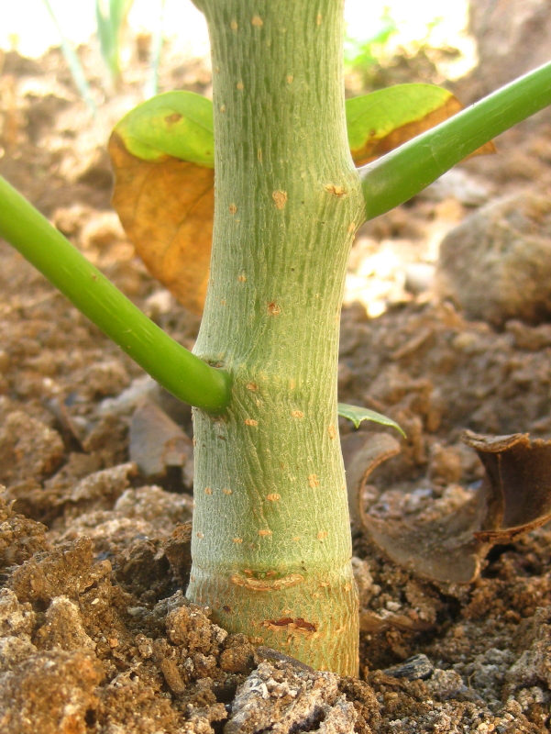
What Jobs Do They Do?
Stem or Trunk
What is a stem or trunk?
Branches, leaves and flowers grow from the stem or trunk.
A trunk is woody, and often has a layer of bark around it.
What job does it do?
The stem or trunk holds the plant up.
It also carries water and nutrients from the roots to the leaves.
Photo courtesy of tonrulkens @flickr.com) - granted under creative commons licence – attribution

Slide 9
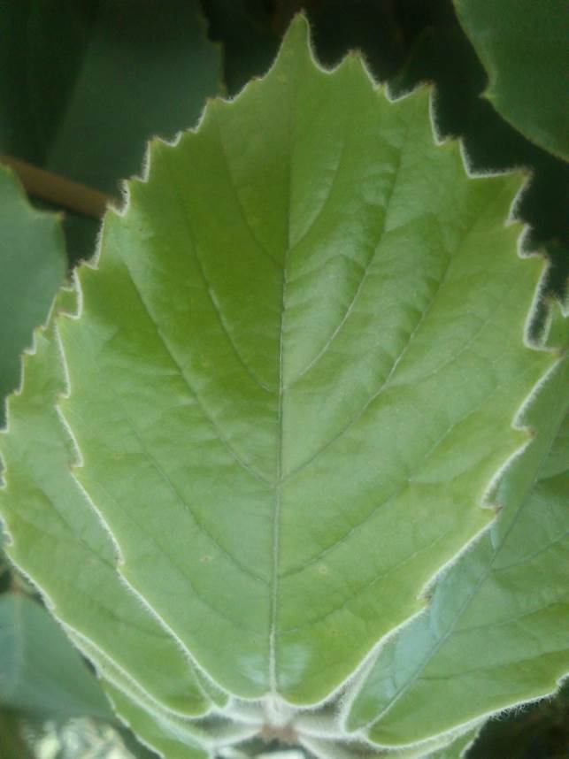
What Jobs Do They Do?
Leaves
What job do leaves do?
The leaves make food for the plant using sunlight and carbon dioxide from the air.
Photo courtesy of leaf watoru @flickr.com) - granted under creative commons licence – attribution

Slide 10
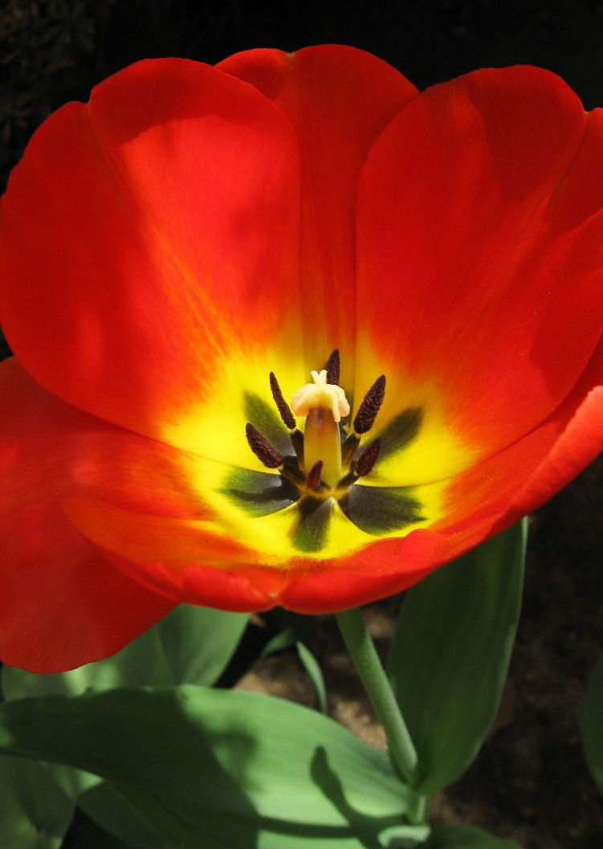
What Jobs Do They Do?
Flowers
Do you know what the flower’s job is?
Flowers are brightly coloured to attract insects and birds.
The insects carry pollen to other flowers.
Flowers use the pollen to make seeds to grow new plants.
Photo courtesy of Puzzler4879 @flickr.com) - granted under creative commons licence – attribution

Slide 11



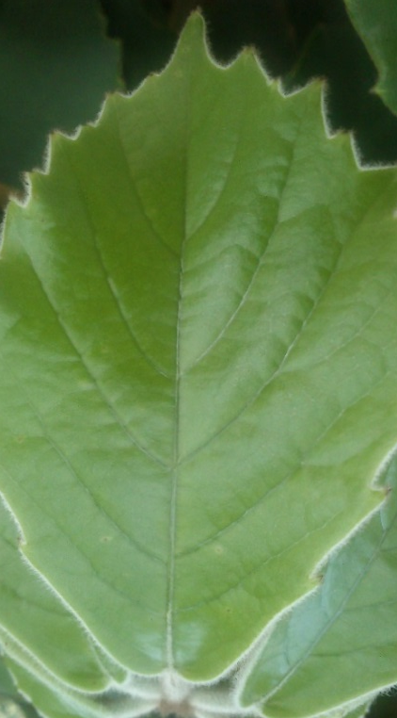
What Can You Remember?
Look at these pictures of the different parts of a plant.
What can you remember about the job or jobs each part does.

Slide 12

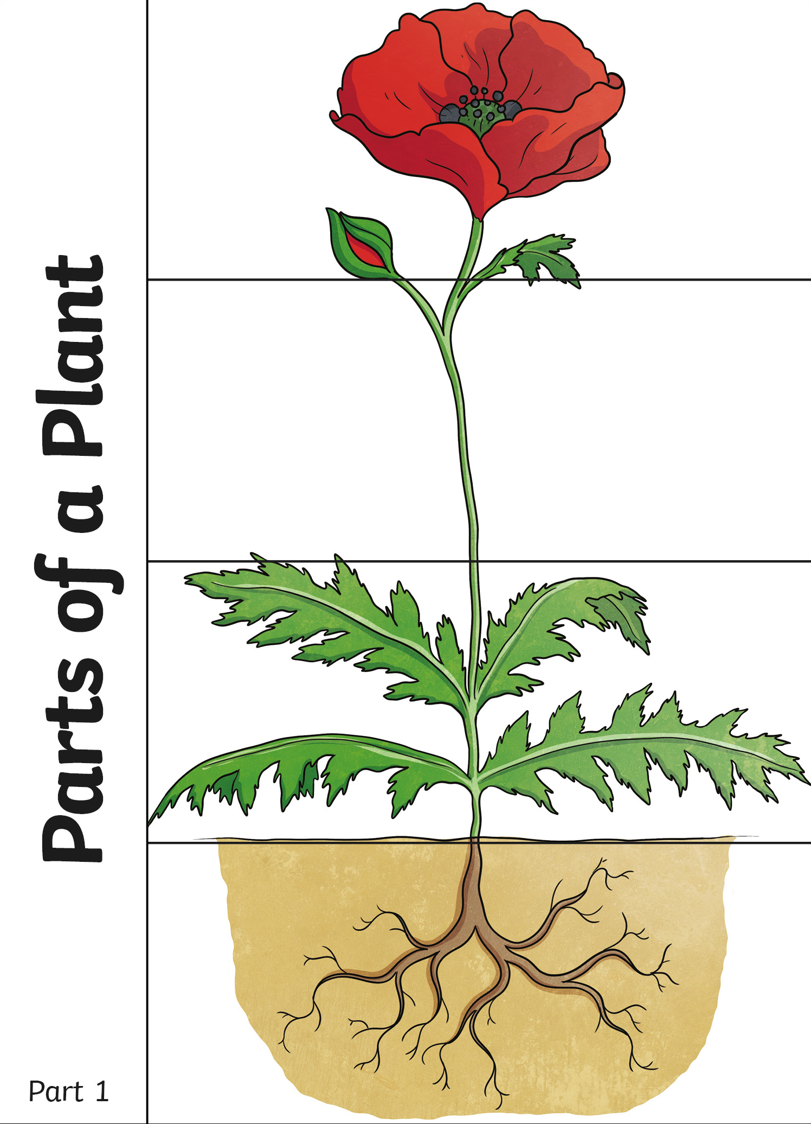
Fun Facts Activity 2
Now is your chance to show what you have learnt!
Your job is to create a folding leaflet to explain the function of the different parts of a plant.
Choose your level of difficulty

Slide 13
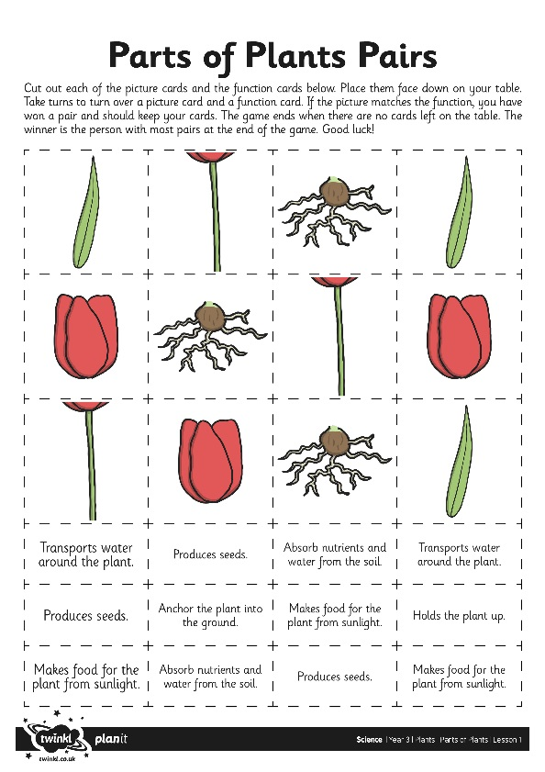

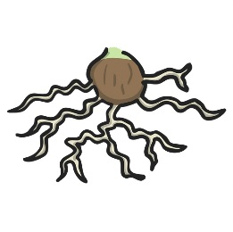



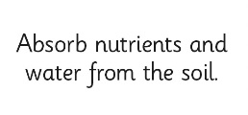
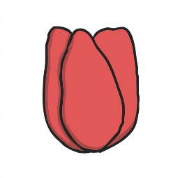
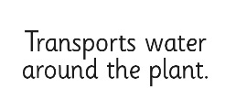
Pairs Game Extension
Play with another member of your family. Use your Pairs Cards to try to match a picture of a part of a plant with its function. The winner is the person with the most pairs.

Slide 14

Aim
I can name the different parts of flowering plants and explain
their jobs.
Success Criteria
I can name the different parts of a plant.
I can explain the jobs that the different parts of a plant do.

