Slide 1




Year 3 - Spring - Block 4
Length & Perimeter

Slide 2
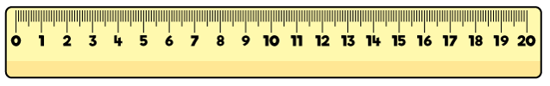
Whitney’s ruler is broken.
How could she use it to still measure items?

Slide 3

Tommy thinks that this chocolate bar is 4 cm long.
Is he correct?
Convince me.

Slide 4
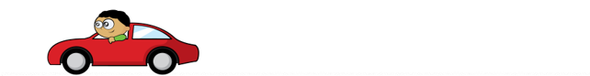
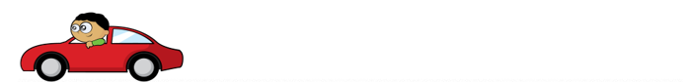
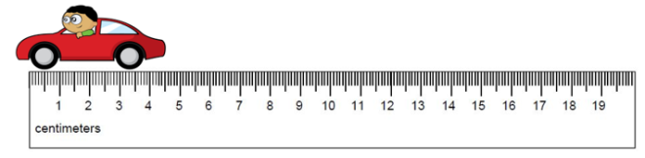
Three children measured the same toy car.
Eva says that the car is 6 cm and 5 mm
Dexter says the car is 5 cm
Annie says the car is 4 cm 5 mm
Who is correct?
Who is incorrect?
Explain why.

Slide 5


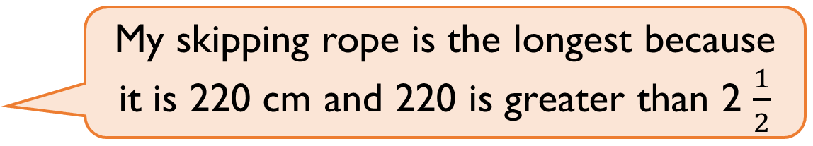

Mo and Alex each have a skipping rope.
Alex says,
Mo says,
Who is correct?
Explain your answer.
I have the longest skipping rope. My skipping rope is 2 $\frac{1}{2}$ metres long.
My skipping rope is the longest because it is 220 cm and 220 is greater than 2 $\frac{1}{2}$

Slide 6



Three children are partitioning 754 cm
Teddy says,
Whitney says,
Jack says,
Who is correct?
Explain why.
75 m and 4 cm
7 m and 54 cm
54 cm and 7 m

Slide 7

Rosie is measuring a sunflower using a 30 cm ruler.
Rosie says,
Rosie is incorrect.
Explain what mistake she might have made.
How tall is the sunflower?
The sunflower is 150 cm tall.

Slide 8

Ron is thinking of a measurement.
Use his clues to work out which measurement he is thinking of.
In mm, my measurement is a multiple of 2
It has 8 cm and some mm
It’s less than 85 mm
In mm, the digit sum is 12

Slide 9
Always, Sometimes, Never?
mm lengths are smaller than cm lengths.

Slide 10
Sort the lengths into the table.
Are any of the lengths equivalent?
Longer than a metre | Shorter than a metre
1 m 65 cm
165 mm
165 m
165 cm
16 cm 5mm
1 cm 65 mm

Slide 11



Eva is building a tower using these blocks.
100 mm 80 mm 50 mm
How many different ways can she build a tower measuring 56 cm?
Can you write your calculations in mm and cm?

Slide 12
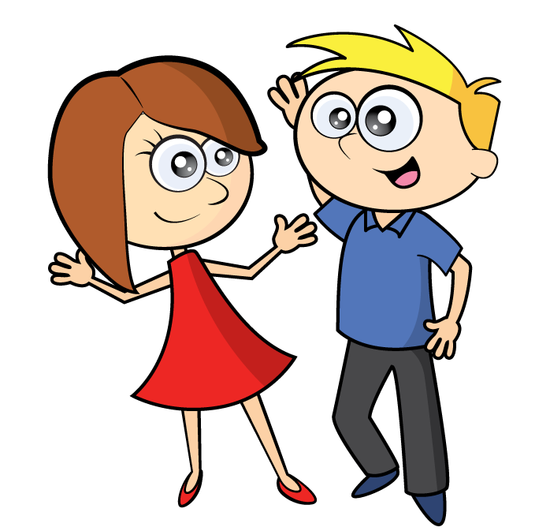


Eva and her brother Jack measured the height of their family.
Eva thinks their total height is 4 m and 55 cm
Jack thinks their total height is 5 m and 89 cm
Who is correct? Prove it.
134 cm
1m and 60 cm
1m and 85 cm
1m and 10 cm

Slide 13
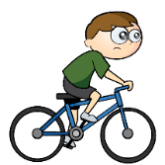
    A bike race is 950 m long.
    Teddy cycles 243 m and stops for a break.
He cycles another 459 m and stops for another break.
How much further does he need to cycle to complete the race?

Slide 14



A train is 20 metres long.
A car is 15 metres shorter than the train.
A bike is 350 cm shorter than the car.
Calculate the length of the car.
Calculate the length of the bike.
How much longer is the train than the bike?

Slide 15

Annie has a 3 m roll of ribbon.
She is cutting it up into 10 cm lengths.
How many lengths can she cut?
Annie gives 240 cm of ribbon to Rosie.
How much ribbon does she have left?
How many 10 cm lengths does she have left?

Slide 16
Amir is measuring the shape below.
He thinks the perimeter is 7 cm.
Can you spot his mistake?
4 cm
3 cm

Slide 17
Whitney is measuring the perimeter of a square.
She says she only needs to measure one side of the square.
Do you agree?
Explain your answer.

Slide 18
Here is a shape made from centimetre squares.
Find the perimeter of the shape.
Can you use 8 centimetre squares to make different shapes?
Find the perimeter of each one.

Slide 19

Teddy says,
Do you agree with Teddy?
Explain your answer.
You only need to know the length of one side of these 2-D shapes to work out the perimeter.

Slide 20
Each side of this shape is of equal length.
The perimeter is 60 cm.
How long is each side?

Slide 21
How many different rectangles can you draw with a perimeter of 20 cm?

