Slide 1
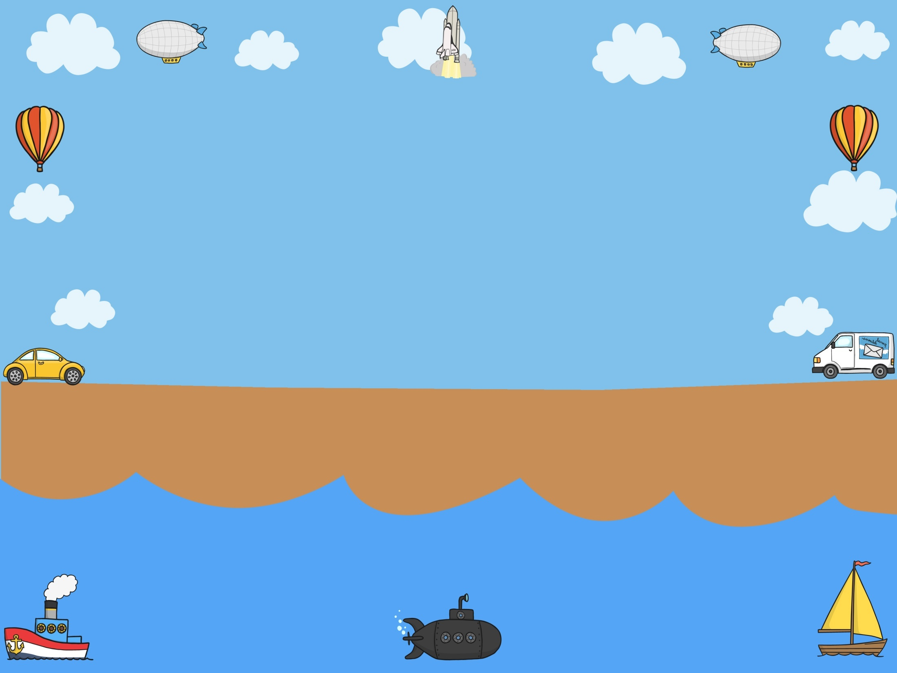
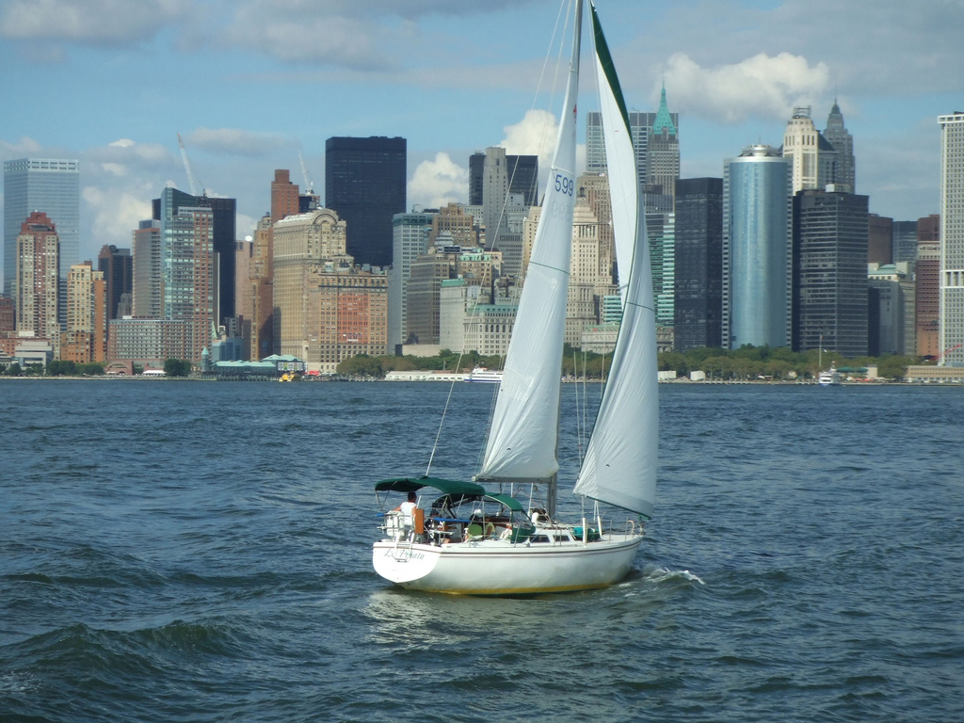

Yacht
Photo courtesy of Phil Of Photos(@flickr.com) - granted under creative commons licence - attribution

Slide 2
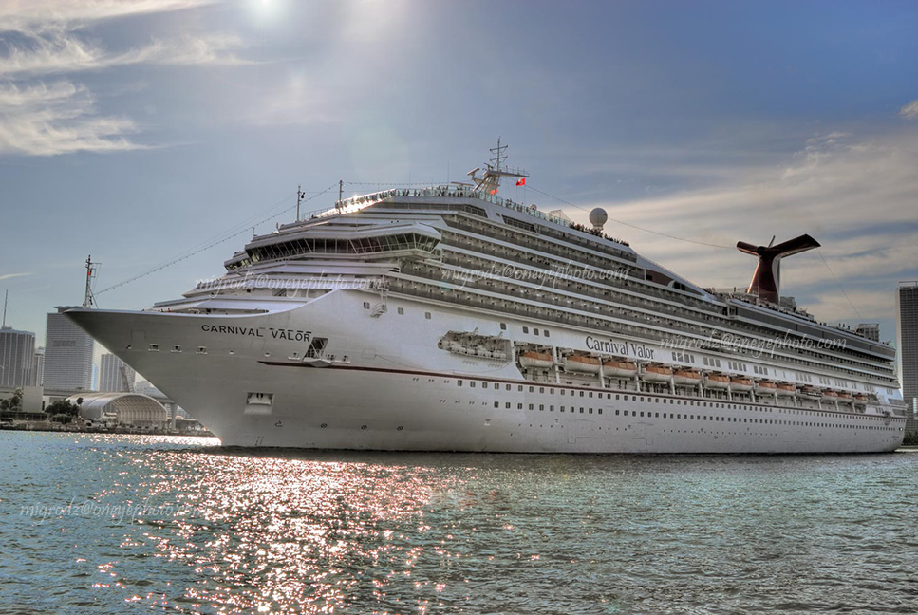
Cruise Ship
Photo courtesy of MigRodz(@flickr.com) - granted under creative commons licence - attribution

Slide 3
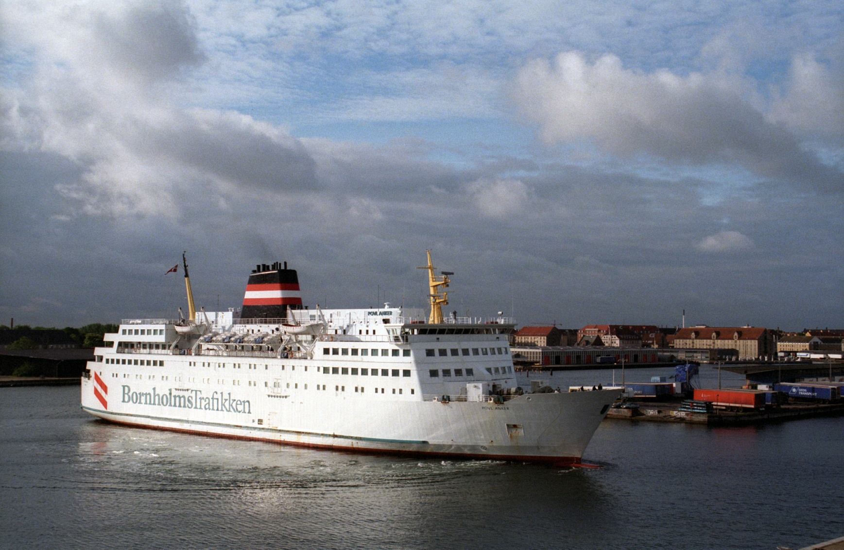
Ferry
Photo courtesy of Lars Plougmann(@flickr.com) - granted under creative commons licence - attribution

Slide 4
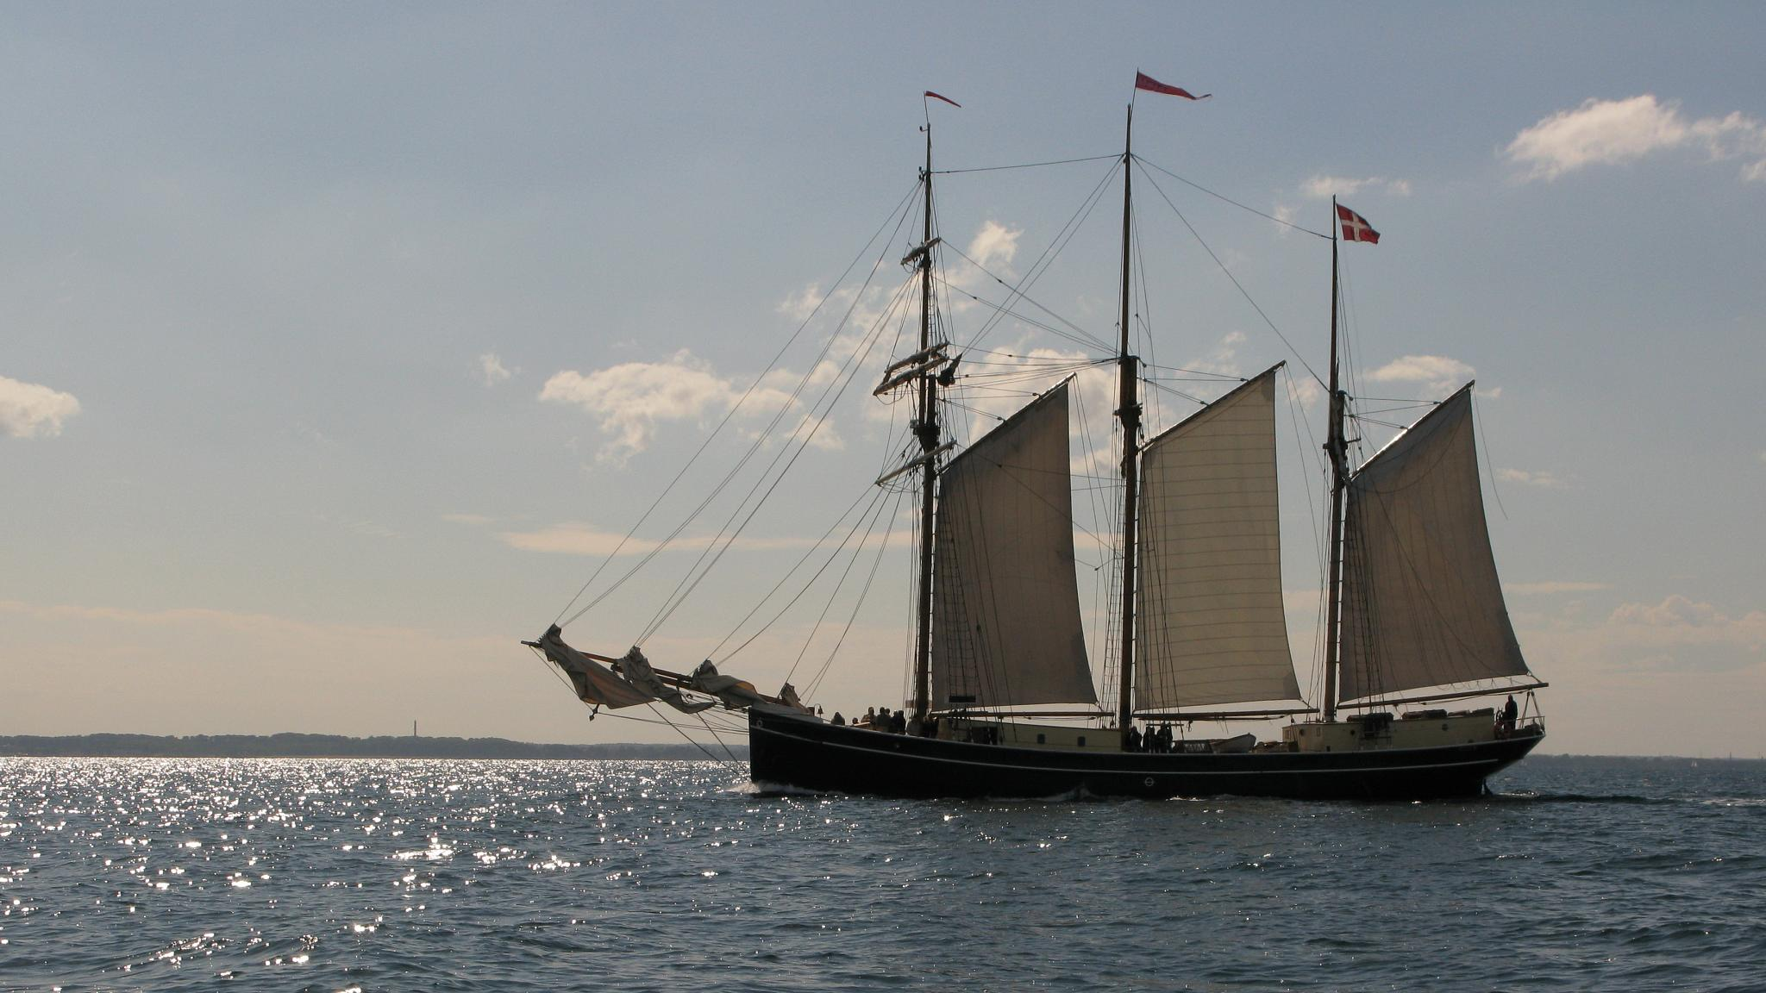
Ship
Photo courtesy of __o__ (@flickr.com) - granted under creative commons licence - attribution

Slide 5
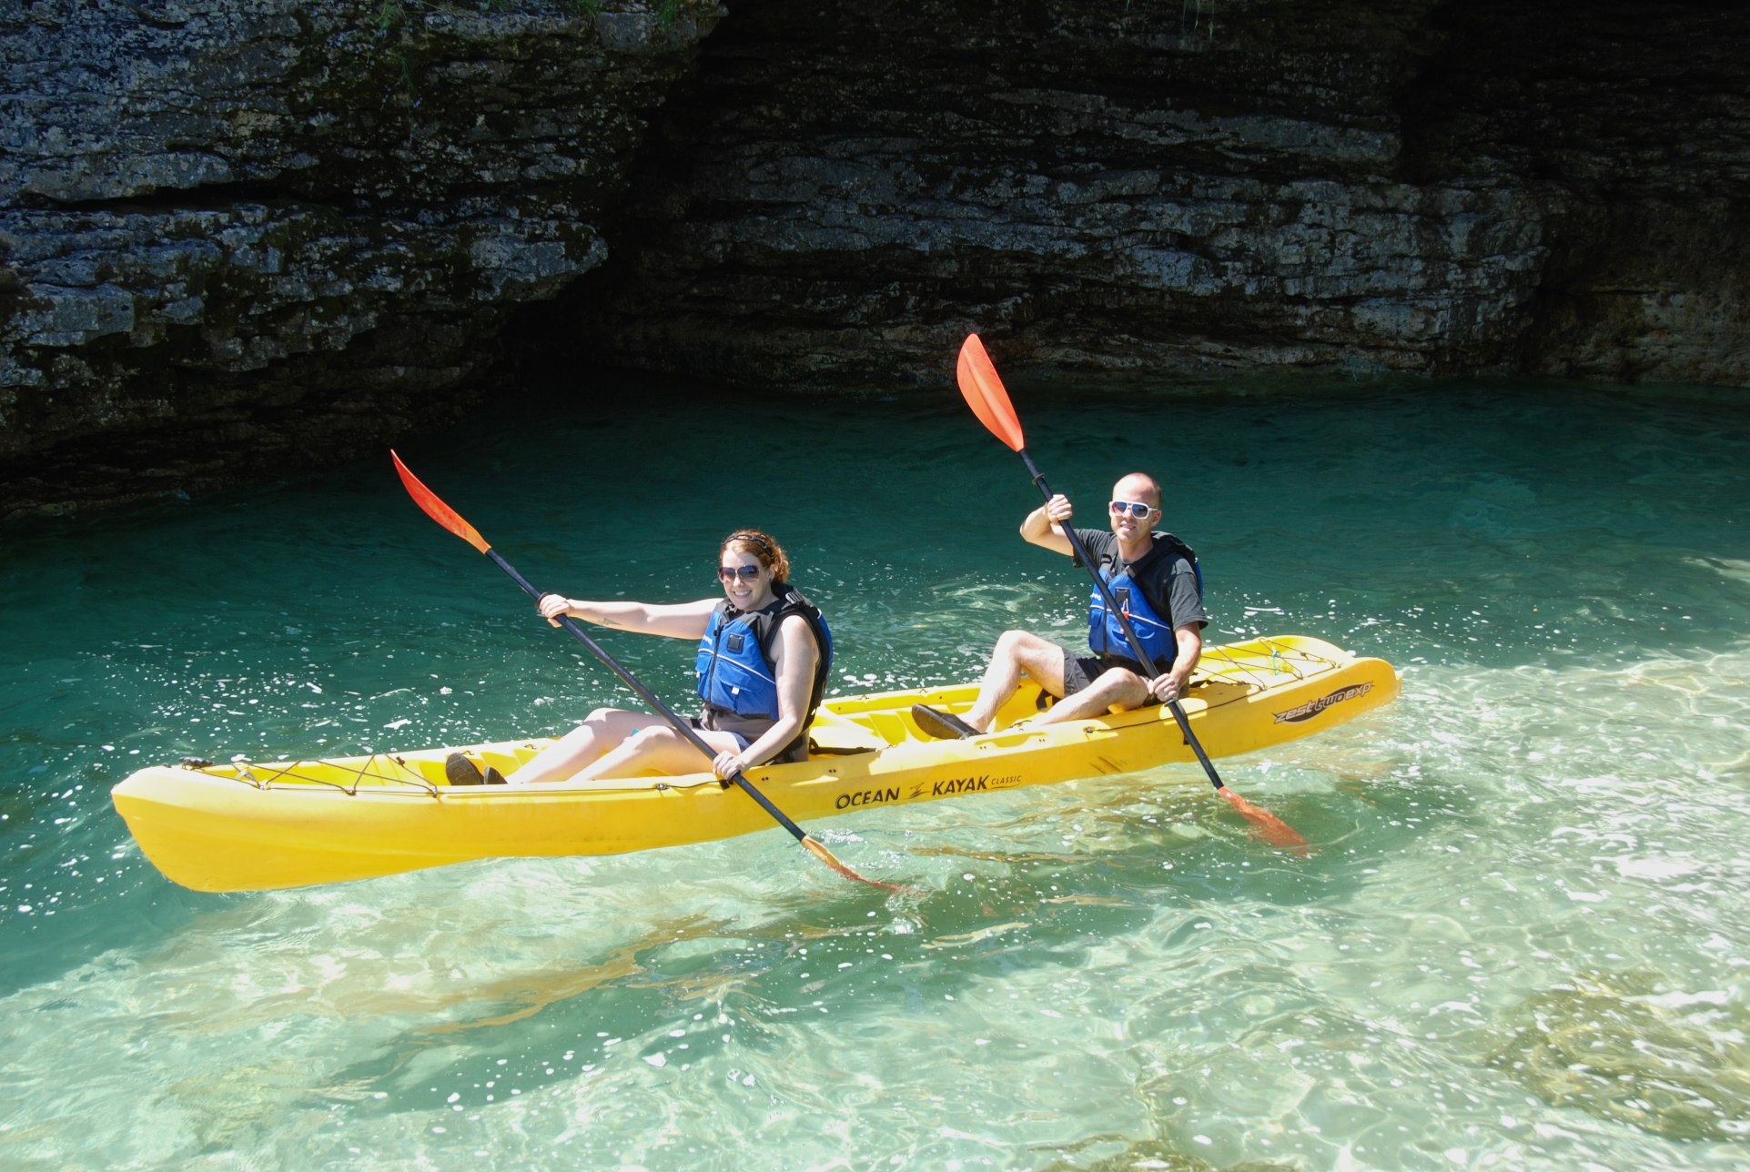
Kayak
Photo courtesy of saidinjest(@flickr.com) - granted under creative commons licence - attribution

Slide 6
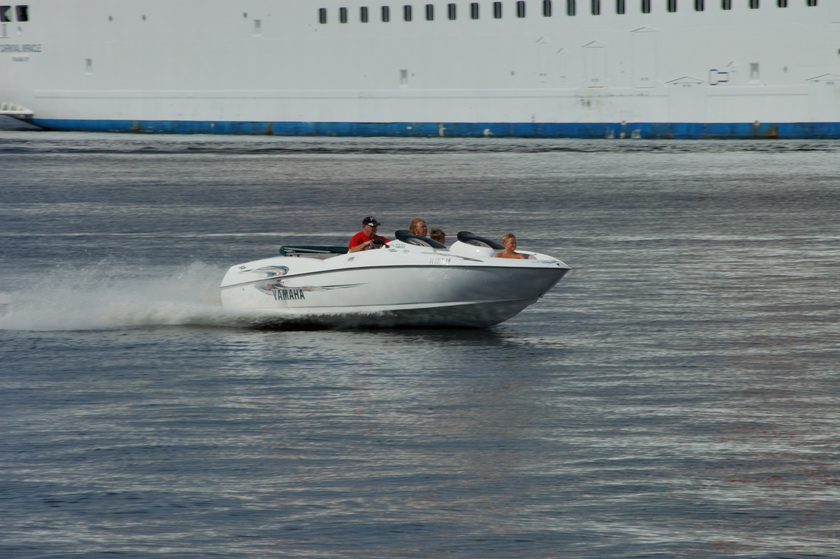
Speedboat
Photo courtesy of Dshalock® Libertarian Emperor of America @flickr.com) - granted under creative commons licence - attribution

Slide 7
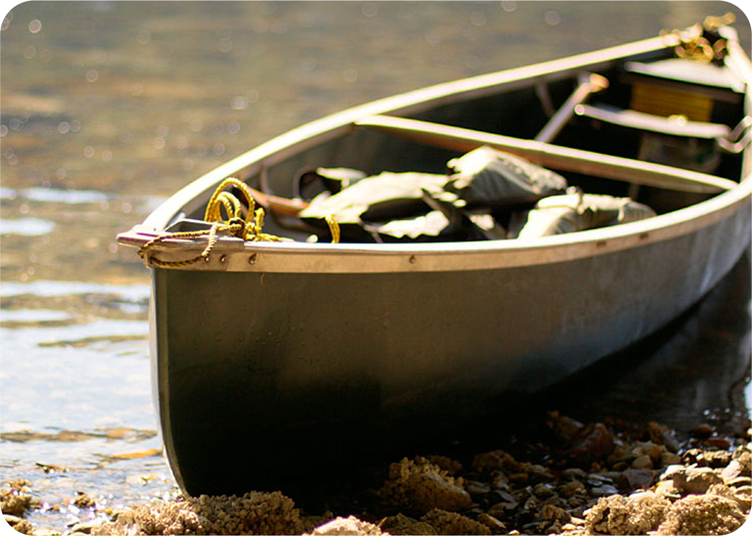
Canoe
Photo courtesy of waferboard(@flickr.com) - granted under creative commons licence - attribution

Slide 8
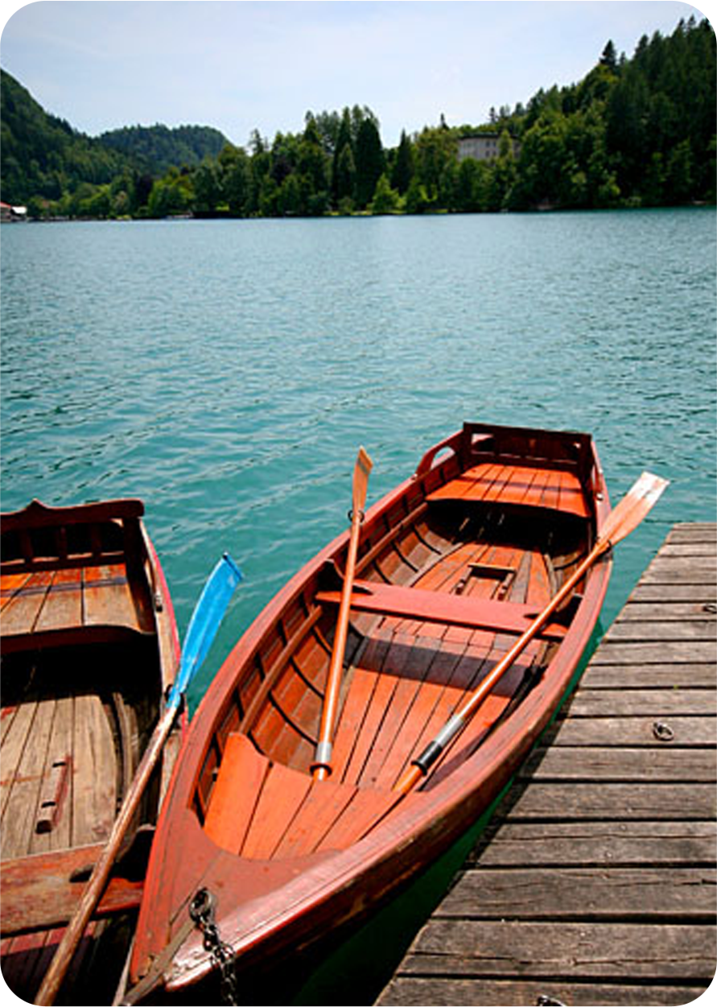
Rowing Boat
Photo courtesy of Dale Harvey(@flickr.com) - granted under creative commons licence - attribution

